Slide 1
Civilian and military medicine face many challenges
Eric Goralnick, MD, MS
Director, Military and Veterans Initiatives, Mass General Brigham
Associate Professor of Emergency Medicine, Harvard Medical School
September 11, 2024

Slide 2
Disclosure
Pending...

Slide 3
52%
of nurses
20%
of physicians
plan to leave clinical practice within 1 year
Murthy, Vivek H. "Confronting health worker burnout and well-being." New England Journal of Medicine 387.7 (2022): 577-579.
Notes:
63% of physicians report burnout
Twice as likely to have patient accidents occur when experiencing burnout

Slide 4
$ 200,000,000 traveler staffing expenses in 2019 in Massachusetts
$ 1,000,000,000+
traveler staffing expenses in 2022 in Massachusetts
Massachusetts Hospital Association 2022.

Slide 5
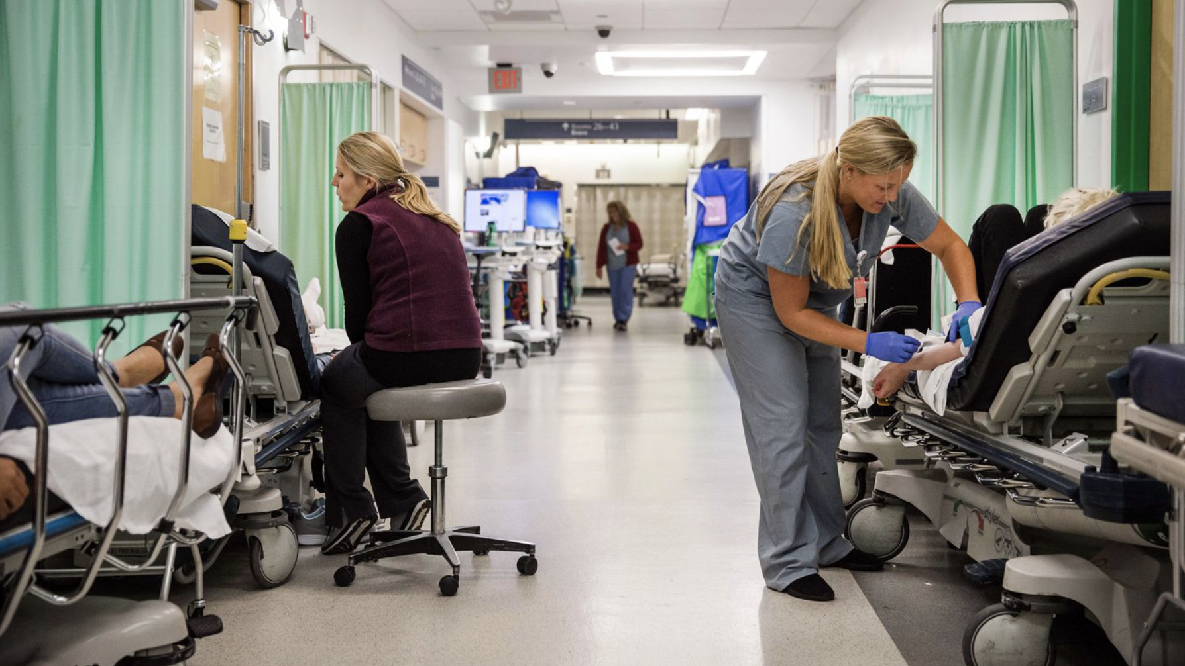

Slide 6
Wartime Medical Lessons are Learned, Lost & Relearned Over Time: The Walker Dip
Vietnam
OEF/OIF
The Next War
Survivability
Mitigate the Walker Dip
Goralnick, E., E. Elster, and J. Woodson. "Improving Care During Peacetime, War and Disasters: A Call for Agile Military Civilian Strategic Alliances." Annals of surgery (2022): 10-1097.

Slide 7
Large Scale Combat Operations: World War 2 Scale with Modern Lethality
Lack of air superiority requires prolonged field
Complex triage and crisis standards of care
Overwhelming casualty numbers
Supply Chain shortfalls
Remondelli, Mason H.; Remick, Kyle N. MD; Shackelford, Stacy A. MD; Gurney, Jennifer M. MD; Pamplin, Jeremy C.; Polk, Travis M. MD; Potter, Benjamin K. MD; Holt, Danielle B. MD. Casualty care implications of large-scale combat operations. Journal of Trauma and Acute Care Surgery 95(2S):p S180-S184, August 2023. | DOI: 10.1097/TA.0000000000004063

Slide 8
Of injured 9/11 veterans:
94% experienced severe physical injuries
91% live with severe mental health conditions
35% incurred Traumatic Brain Injuries
/data-sheets/2021/2021-National-Veteran-Suicide-Prevention-Annual-Report-FINAL-9-8-21.pdf
https://www.woundedwarriorproject.org/media/ixqbka3q/2021-executive-summary.pdf

Slide 9
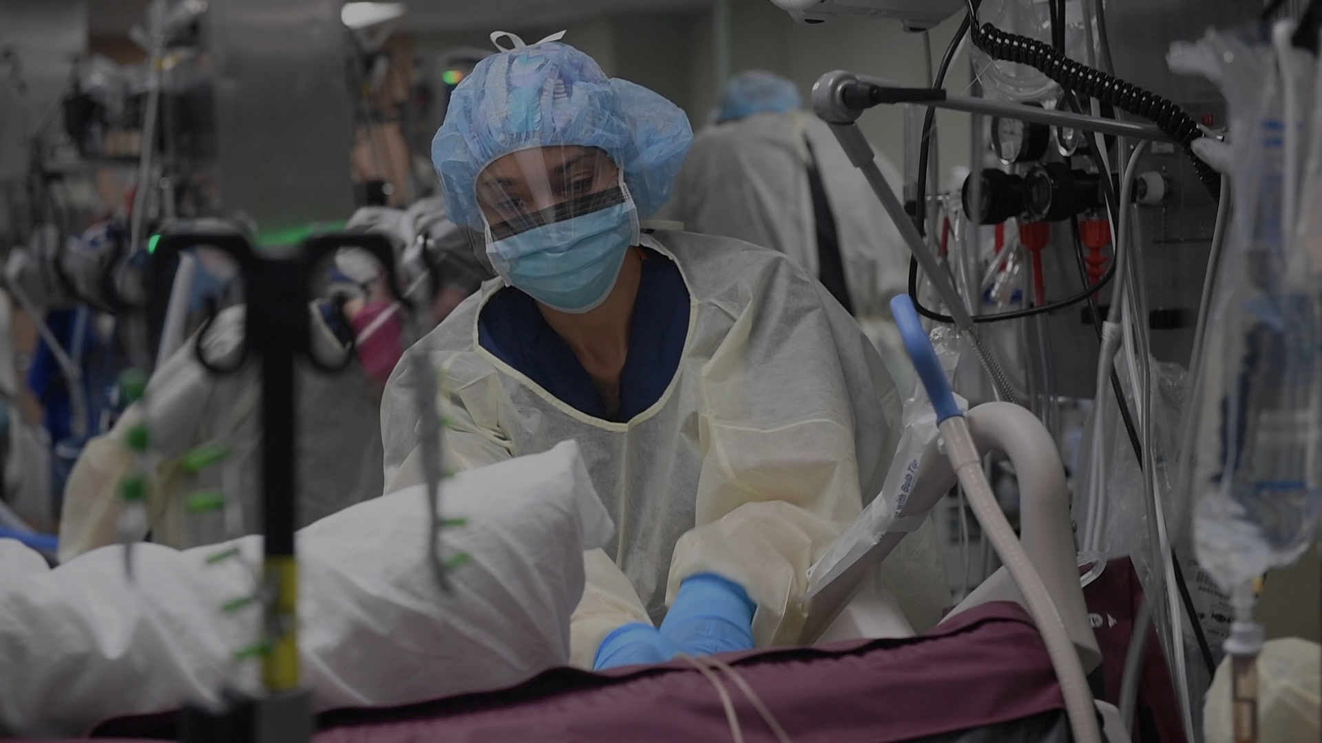
But we have an opportunity to help each other.
U.S. Navy photo by Mass Communication Specialist 2nd Class Sara Eshleman, courtesy of U.S. Navy Medicine.

Slide 10
Military and Veterans Initiative
Mission:
Solve military, veterans, and their families’ greatest medical challenges and translate solutions to MGB patients and the public.
Notes:
Current efforts differ in audiences & goals but lack a true focus on healthcare....
I have spent the last 5 months benchmarking: understanding the strengths, weakness and opportunities in this space.
We know that others institutions have an element of what we are trying to do with MVI, but none has our complete value proposition.

Slide 11
Education
Veteran Transition
Research

Slide 12
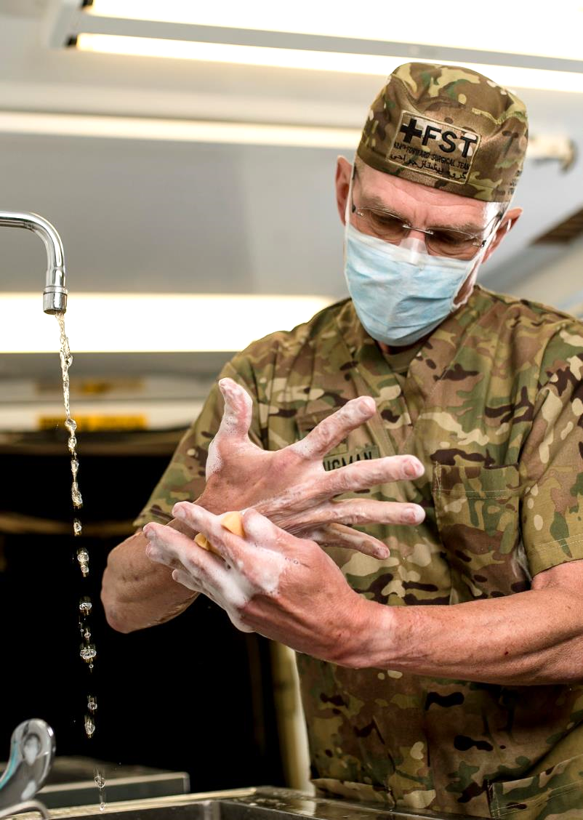
Education
Sustain a ready military medical force
Improve civilian care through sharing of military innovation
Develop clinical rotations, fellowships, and classroom courses
U.S. Army Reserve photo by Master Sgt. Michel Sauret. Courtesy of U.S. Army New England Recruiting Battalion.

Slide 13
Education
2,430 residents & fellows in 320 graduate medical education programs
Photo by StockSnap, courtesy of Pixabay.

Slide 14
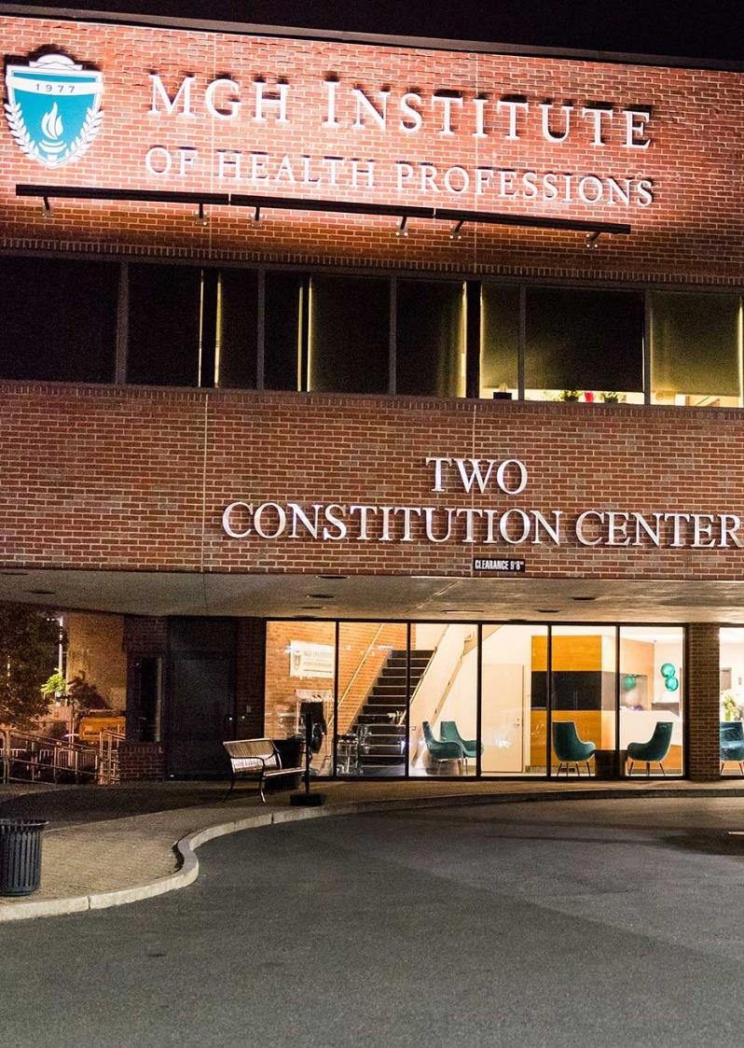
Education
21 degree programs in allied healthcare professions
Extensive continuing education programs
Photo courtesy of MGH Institute of Health Professions.

Slide 15
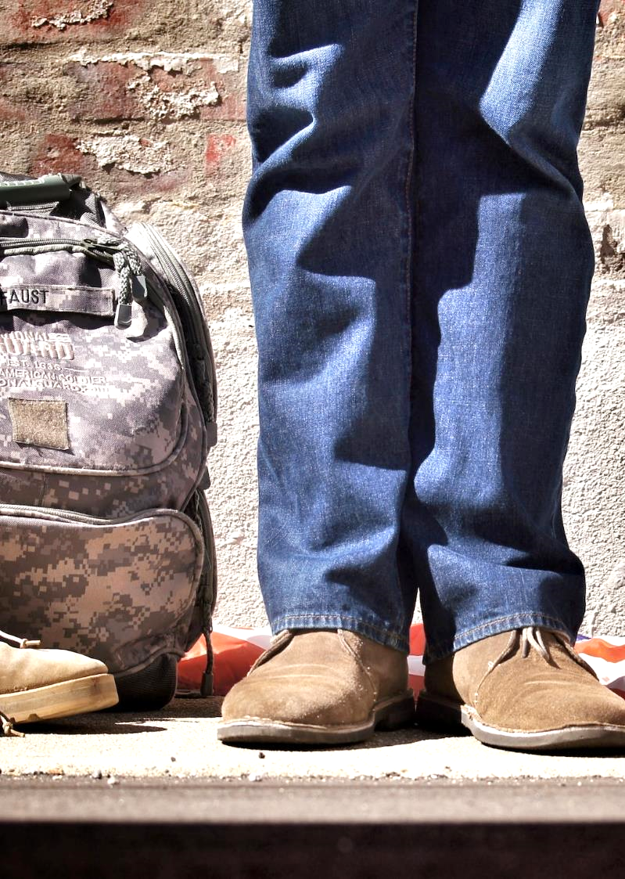
200,000 veterans transition out of the military annually.
Many want to continue to serve in their communities.
https://www.dol.gov/agencies/vets/programs/tap
Photo by Benjamin Faust, courtesy of Unsplash.
Notes:
We know veterans exhibit resilience, assume high levels of trust, and are adept with uncertainty
Further, 60% of veterans describe themselves as underemployed...

Slide 16
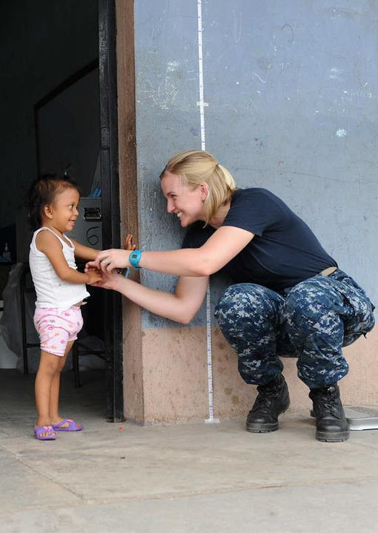
Veteran Transition
Expose veterans & military families to civilian healthcare opportunities with Veteran Service Organizations
Educate through assessment, counseling, & mentorship
Build pathways with affiliate educational institutions and employers
U.S. Air Force photo by Staff Sgt. Alesia Goosic. Released, courtesy of U.S. Navy.
Notes:
Brought three slides into one slide...

Slide 17
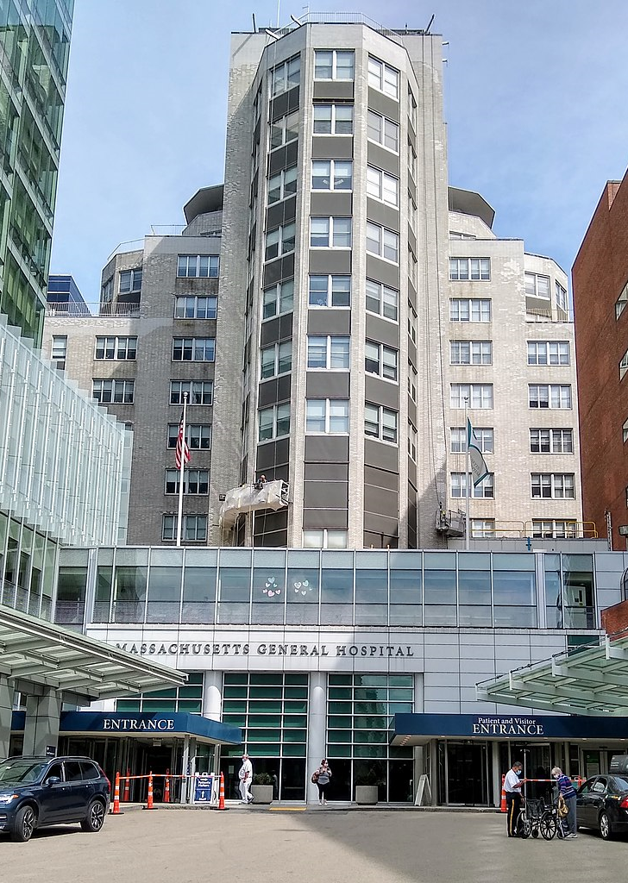
Clinical Sites
11 acute care hospitals, including
2 level 1 Trauma Centers
Photo by Whoisjohngalt, courtesy of Wikimedia Commons.

Slide 18
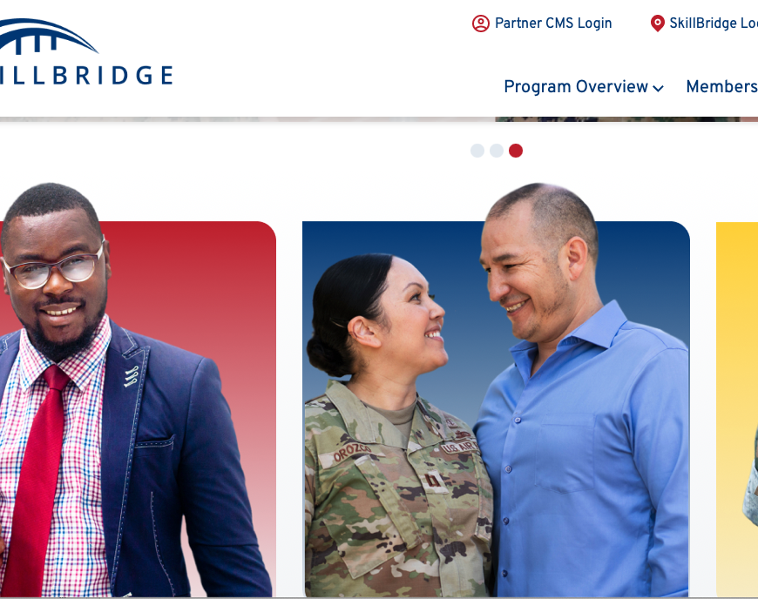
Pilot Programs
First Pilot Program:
Skill Bridge
Second Pilot Program: Military 2 Medicine
Notes:
First Pilot: Skill Bridge
6-month internship for transitioning active-duty personnel
MGB is now a SB industry partner
Second Pilot: Military 2 Medicine
Employs medics and corpsmen in a healthcare role commensurate with their military education, training, and experience
Modeled on VA Intermediate Care Technician Program

Slide 19
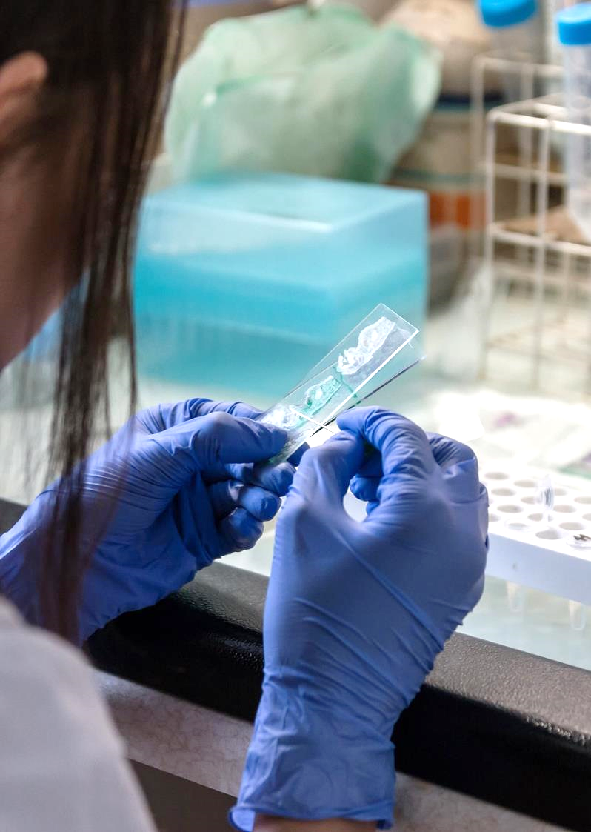
Research
Conduct actionable & impactful research
Advance health practice & policy
Photo by Michal Jarmoluk, courtesy of Pixabay.

Slide 20
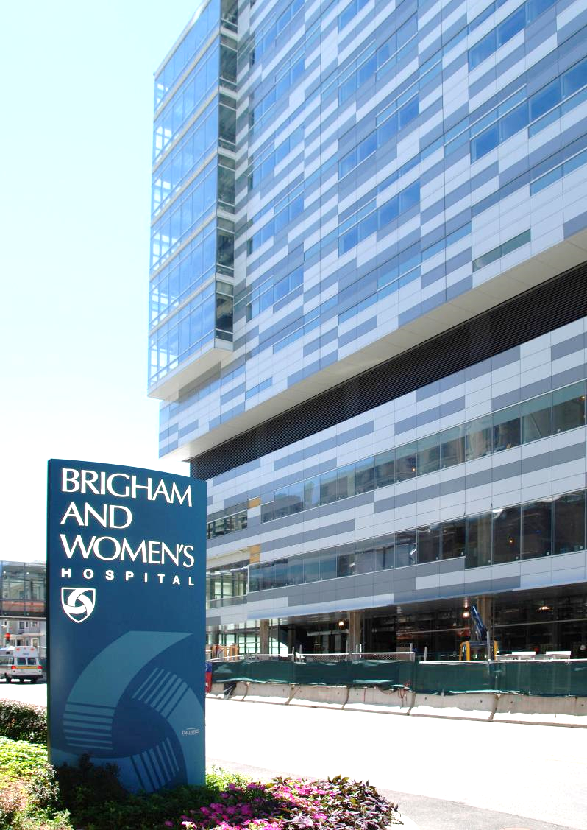
Research
$2 billion annual research budget at MGB
#1 & #2 NIH-funded hospitals
Photo courtesy of Brigham and Women’s Hospital.

Slide 21
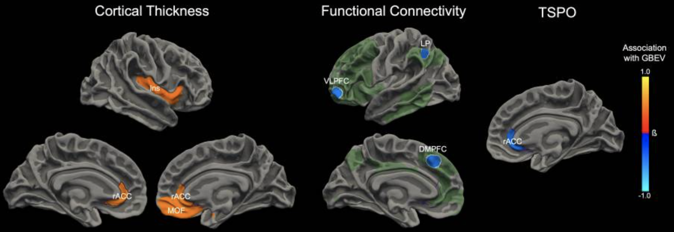
ReBlast: Identify Diagnostic Biomarkers of brain injury with repeated Blast Injury
30 Special Operations Personnel
Higher Blast Exposure associated with:
Worse quality of life
Decreased signal in the right rostral anterior cingulate cortex, which modulates cognition and emotion
Examples of successful needle insertion to femoral vein
Normotensive
Hypotensive
Gilmore N, Tseng CJ, Maffei C, Tromly SL, Deary KB, McKinney IR, Kelemen JN, Healy BC, Hu CG, Ramos-Llordén G, Masood M, Cali RJ, Guo J, Belanger HG, Yao EF, Baxter T, Fischl B, Foulkes AS, Polimeni JR, Rosen BR, Perl DP, Hooker JM, Zürcher NR, Huang SY, Kimberly WT, Greve DN, Mac Donald CL, Dams-O'Connor K, Bodien YG, Edlow BL. Impact of repeated blast exposure on active-duty United States Special Operations Forces. Proc Natl Acad Sci U S A. 2024 May 7;121(19):e2313568121. doi: 10.1073/pnas.2313568121. Epub 2024 Apr 22. PMID: 38648470; PMCID: PMC11087753.
CFA: Common Femoral Artery
CFV: Common Femoral Vein

Slide 22
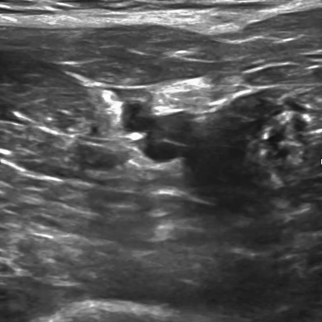
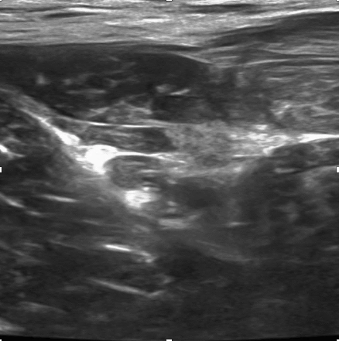
Ultrasound Guided Handheld Device for Femoral Vascular Access: MGH & MIT LL Expert Physician, Porcine Testing
Normotensive: 31/32 success rate
1 trial needed 2 attempts
1 trial needed 3 attempts
1 trial failed after 3 attempts
Hypotensive: 31/32 success rate
6 trials needed 2 attempts
1 trial failed after 3 attempts
Examples of successful needle insertion to femoral vein
Normotensive
Hypotensive
CFA
CFV
CFA
CFV
Needle tip
Needle tip
Initial data indicates needle placement accuracy requirement is met on high-fidelity preclinical model
Brattain LJ et al. AI-Enabled, Ultrasound-Guided Handheld Robotic Device for Femoral Vascular Access. Biosensors 2021
CFA: Common Femoral Artery
CFV: Common Femoral Vein

Slide 23
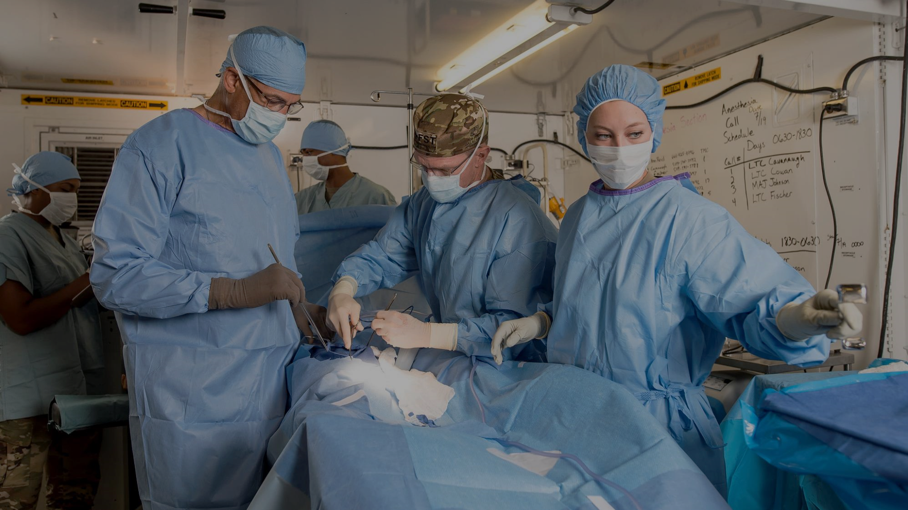
What’s next?
U.S. Army Reserve photo by Master Sgt. Michel Sauret, courtesy of U.S. Army New England Recruiting Battalion.

Slide 24
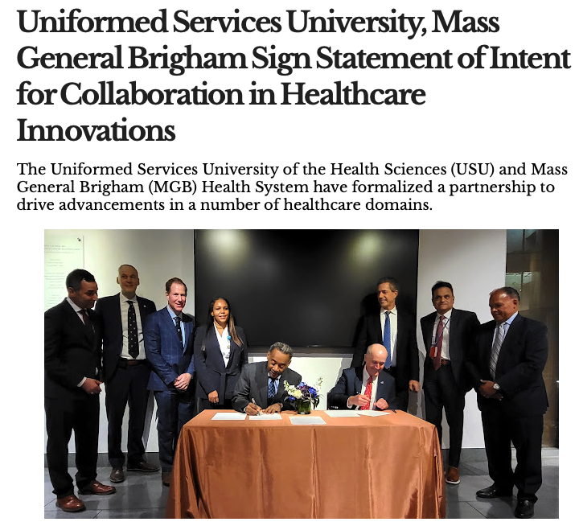
Building Strategic Partnerships
Uniformed Services University
MIT Lincoln Labs
Draper Laboratory
UMASS Lowell
Photo by RODNAE Productions, courtesy of Pexels.

Slide 25
Military and Veterans Initiative
Mission:
Solve military, veterans, and their families’ greatest medical challenges and translate solutions to MGB patients and the public.
Notes:
Current efforts differ in audiences & goals but lack a true focus on healthcare....
I have spent the last 5 months benchmarking: understanding the strengths, weakness and opportunities in this space.
We know that others institutions have an element of what we are trying to do with MVI, but none has our complete value proposition.

Slide 26
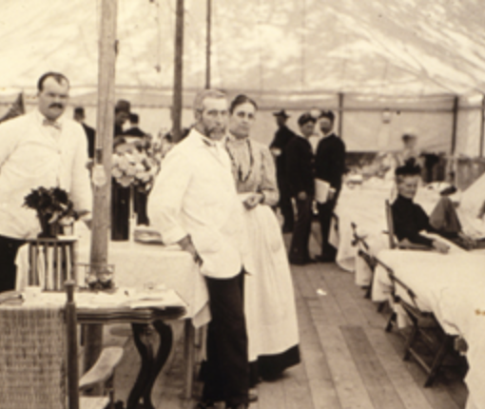
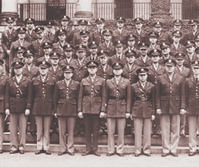
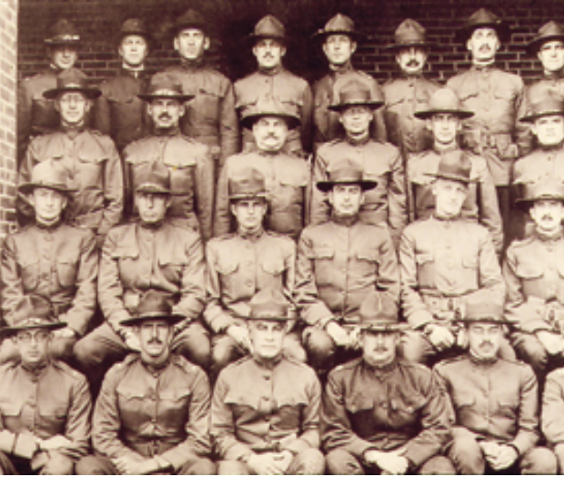
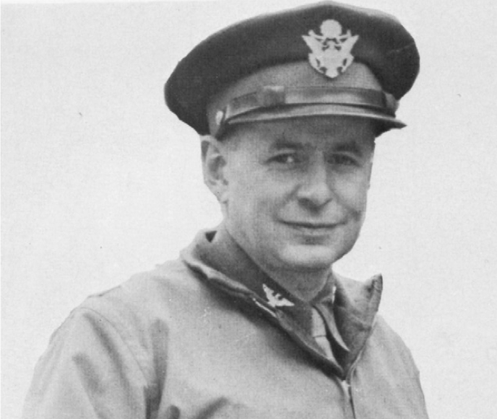
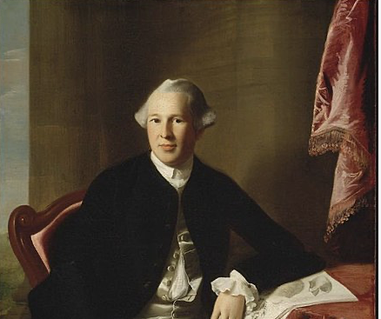
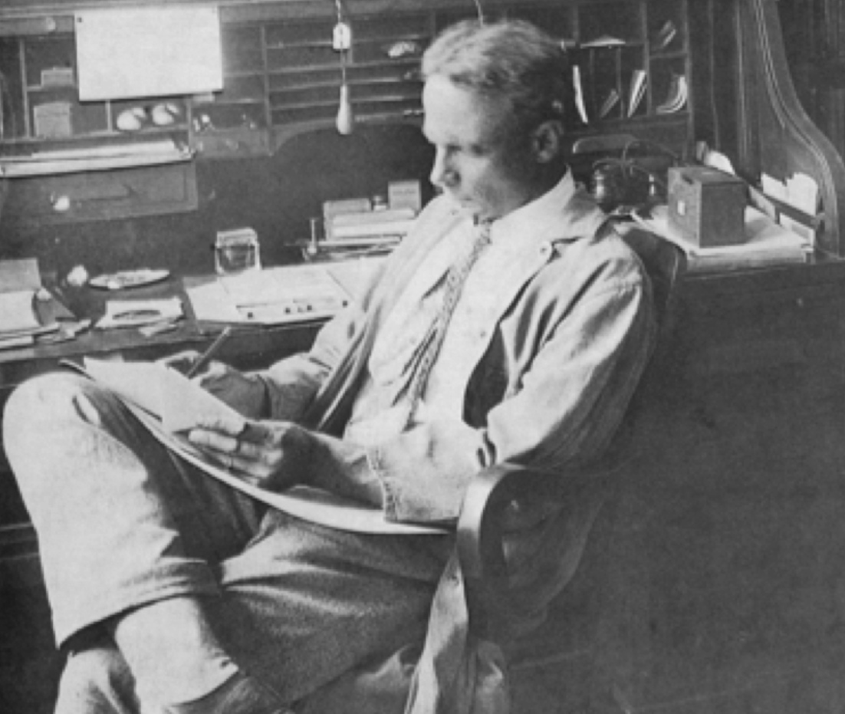
Notes:
https://www.massgeneral.org/museum/exhibits/front-lines/mass-general-on-the-front-lines
merican Revolution (1775 to 1783)
Maj. Gen. Joseph Warren, MD—uncle of John Collins Warren, MD, one of the Mass General founders—was killed while fighting in the Battle of Bunker Hill. Before his death, Warren had helped push for smallpox inoculations among soldiers in the Continental Army.
Mexican-American War (1846 to 1848)
The first public demonstration of ether as a surgical anesthetic took place at the Mass General on Oct. 16, 1846. It was used by the U.S. Army and Navy the following spring and became part of the issued supplies.
1861:
Henry Jacob Bigelow, MD, a Mass General surgeon, presented a series of lectures for 200 Mass General assistant surgeons to help prepare them to serve as military surgeons. The training was considered ahead of its time, as an army general helped to instruct surgeons on types of wounds they could expect to treat.
Civil War
n Dec. 6, 1917, a munitions ship exploded in Halifax Harbour in Nova Scotia, nearly destroying the city. A Mass General contingency joined the relief train that Boston sent to aid the city. Since 1917, Nova Scotia has sent the City of Boston a large tree each Christmas in recognition of this aid.
In May 1917, U.S. Army Base Hospital No. 6, a medical/surgical unit of Mass General physicians and nurses, was activated under the command of Col. Frederic A. Washburn, MD, director of the hospital. The unit would later be reactivated by the government during World War II and would be called the 6th General Hospital.
Stanley Cobb, MD, the first chief of psychiatry at Mass General, researched “shell shock,” “soldier’s heart” and “neurocirculatory asthenia”—phrases all used to describe what is now called post-traumatic stress disorder (PTSD).
Beginning in 1941, the hospital developed advanced triage techniques for large-scale civilian disasters, such as an unexpected U-boat attack. This preparation ultimately enabled Mass General to care for the victims of the Cocoanut Grove fire in 1942.
Edward Churchill , excelsior society
Vietnam War (1955 to 1975)
Mass General research made long-term storage of blood practical, lengthening the number of days donor blood could be stored. This allowed for the transport of blood to soldiers halfway across the world.

Slide 27
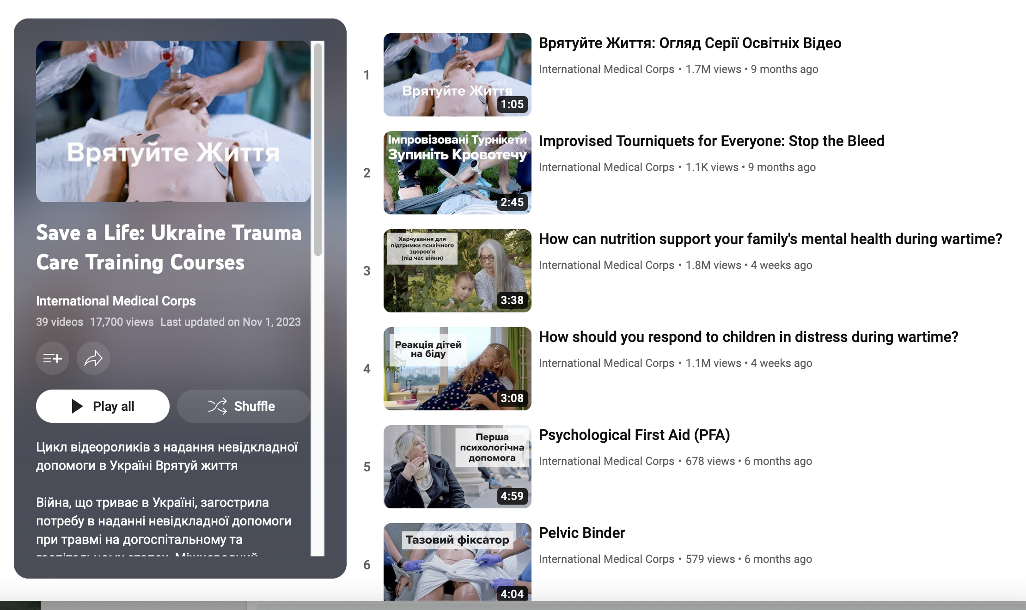

Slide 28
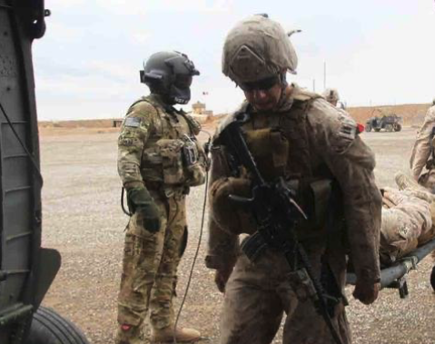
Second Pilot Program: Military 2 Medicine
Employs medics and corpsmen in a healthcare role commensurate with their military education, training, and experience
Modeled on VA Intermediate Care Technician Program

