Slide 1
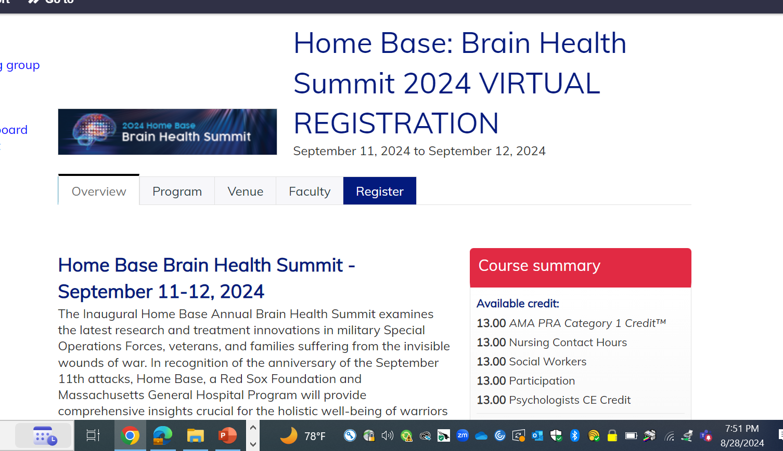
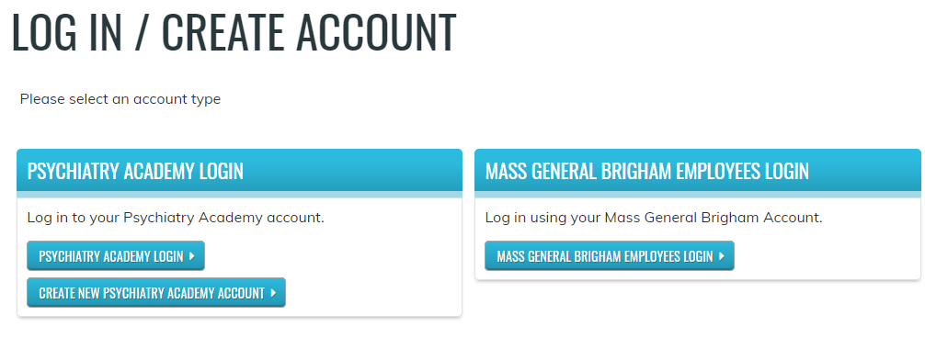
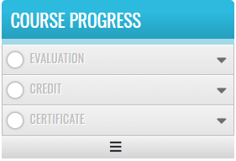
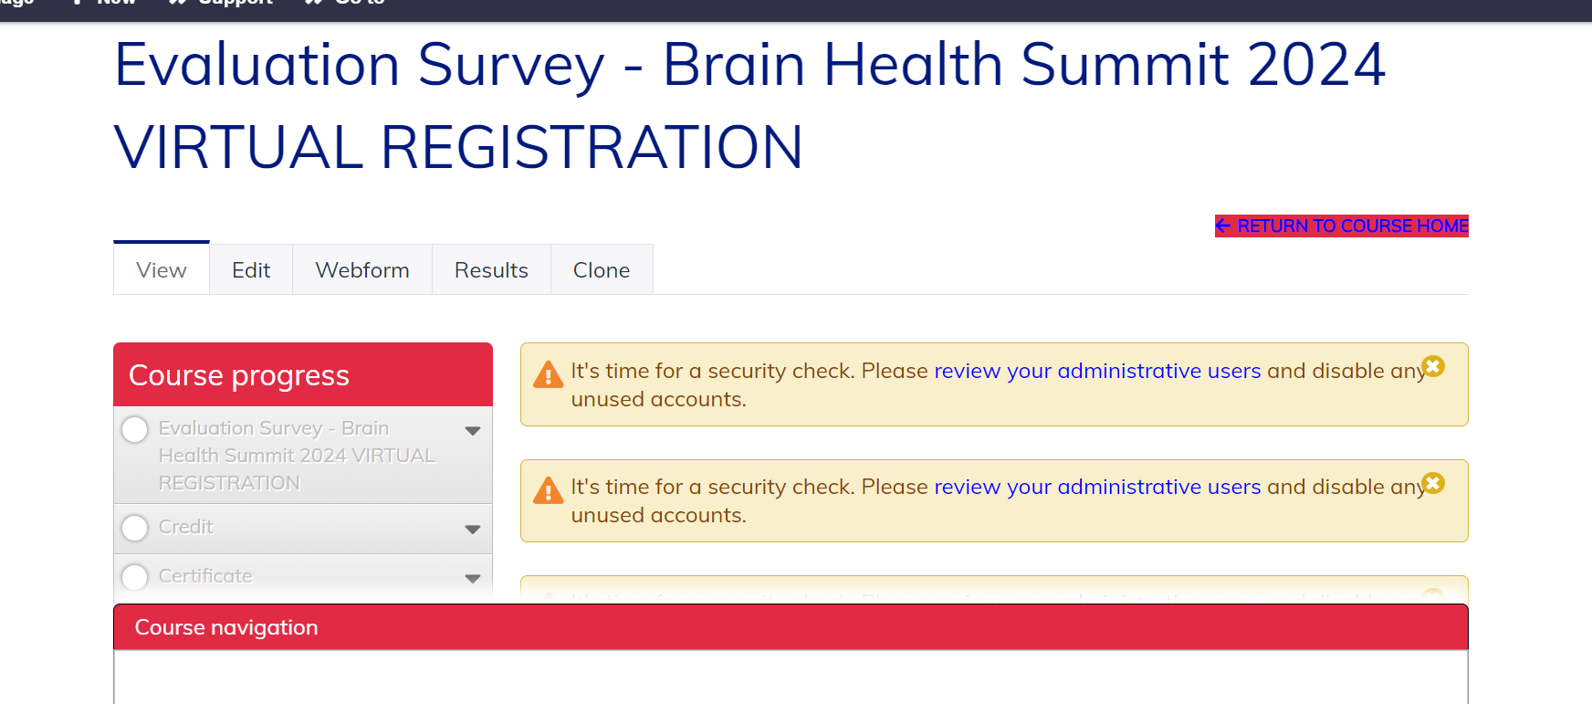
Three Steps to Claiming your CME Credit…
1
2
3
1: Visit https://lms.mghcme.org/lms.homebase.org/BrainHealthSummit2024Virtual
and click on the Register/Take Course button.
2: Enter your ‘Academy Login’ username and password then click the ‘Login’ button.
If you have forgotten your password, please click the ‘Forgot Visitor Password’ button. Once logged in, click on the blue Take Course button.
3: Click on the ‘Evaluation’ button. Once you have completed your evaluation, and attested to the number of sessions you attended, your certificate will be generated. You should claim only the credit commensurate with the extent of your participation in the activity. Complete the evaluation and claim your credit by:
October 12, 2024

