Slide 1






The Evolving Landscape of Adolescent Cannabis Use
Randi M. Schuster, PhD
Associate Professor, Harvard Medical School
Director, MGH Center for School Behavioral Health

Slide 2
Disclosures
Neither I nor my spouse/partner has a relevant financial relationship with a commercial interest to disclose.

Slide 3
Let me skip to the punchlines…

Slide 4
Most teens do not use substances.
But many do.

Slide 5
While overall rates of cannabis use have remained stable, the overall landscape of use has done a 180.

Slide 6
There is a lot we don’t understand.
(And we need to be honest about that.)

Slide 7
There are three things we know….
1. Adolescence is a period of increased risk for substance use initiation. There are subgroups where this risk is even greater.
2. Adolescents are at heightened risk for negative effects.
3. Adolescents who use (any) substances are more likely to experience other mental health concerns.
4. Schools are well poised to represent the prevention arm of our mental health system.

Slide 8
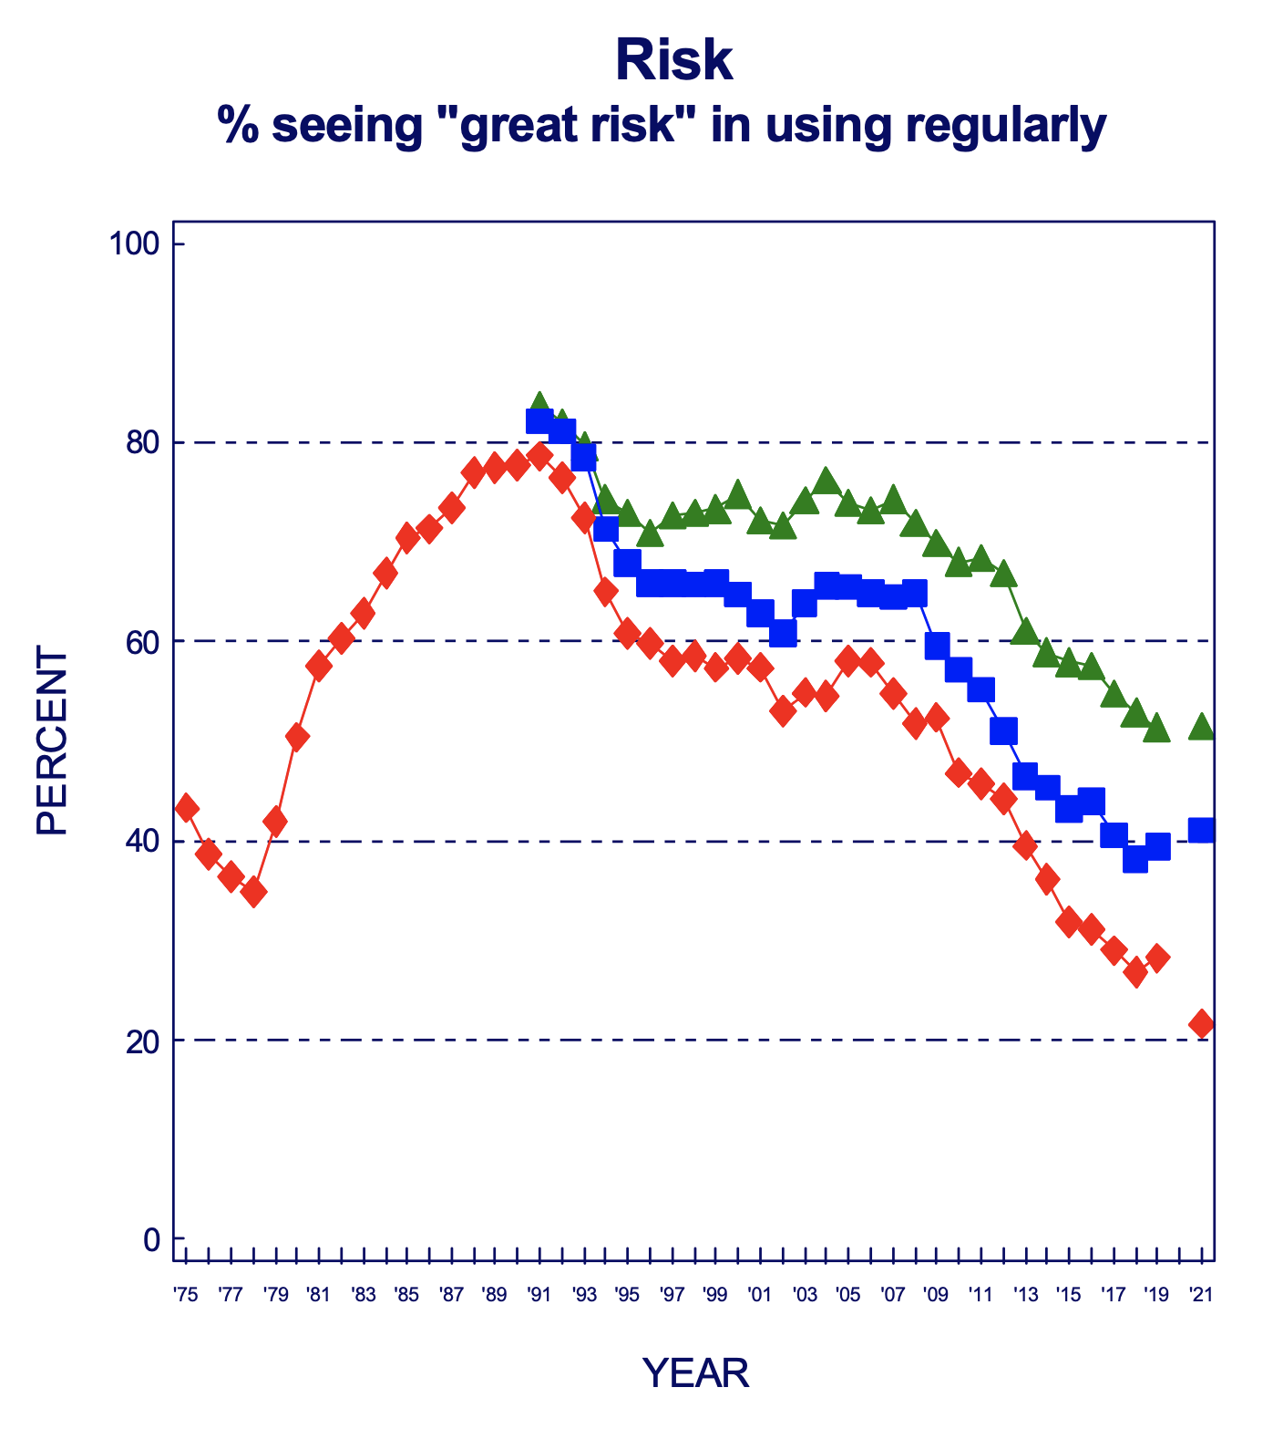
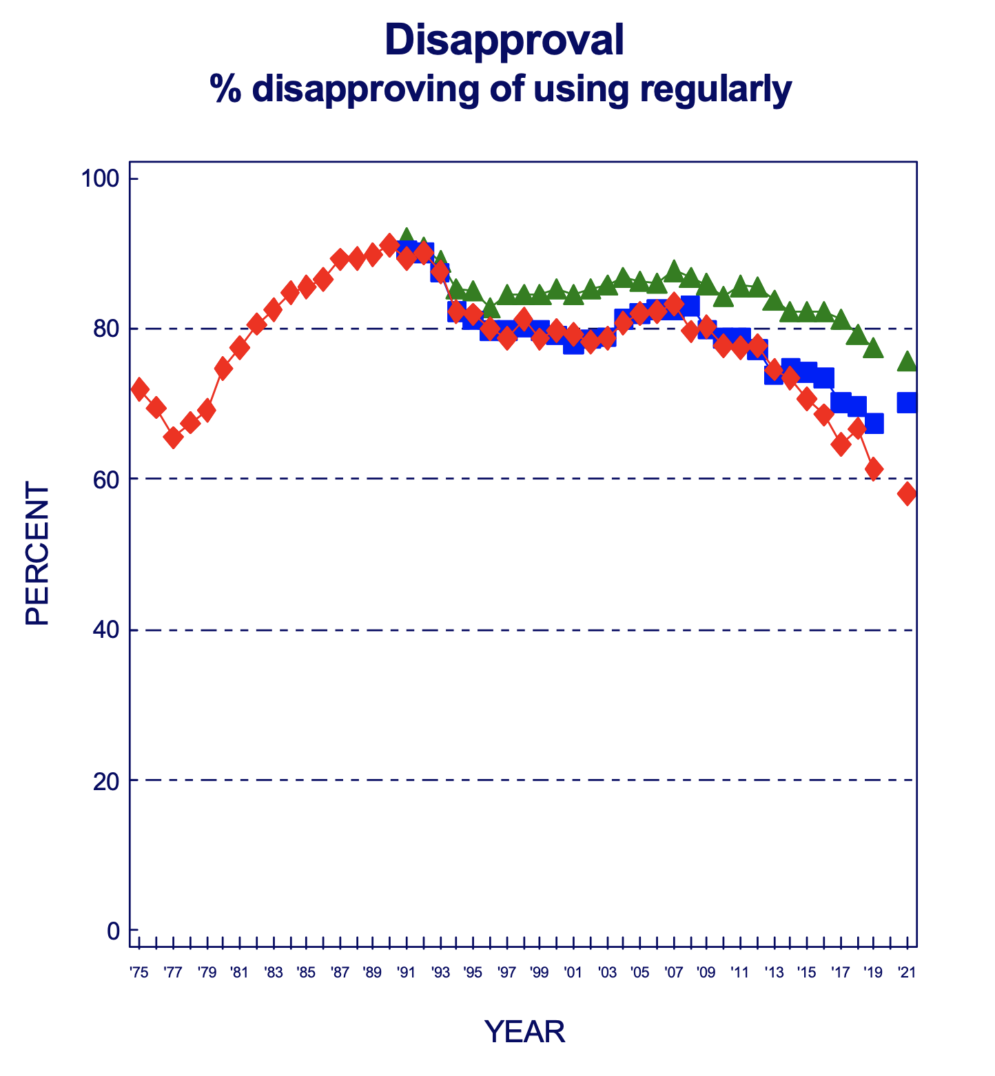

CHANGES IN PERCEPTIONS
OF HARM

Slide 9
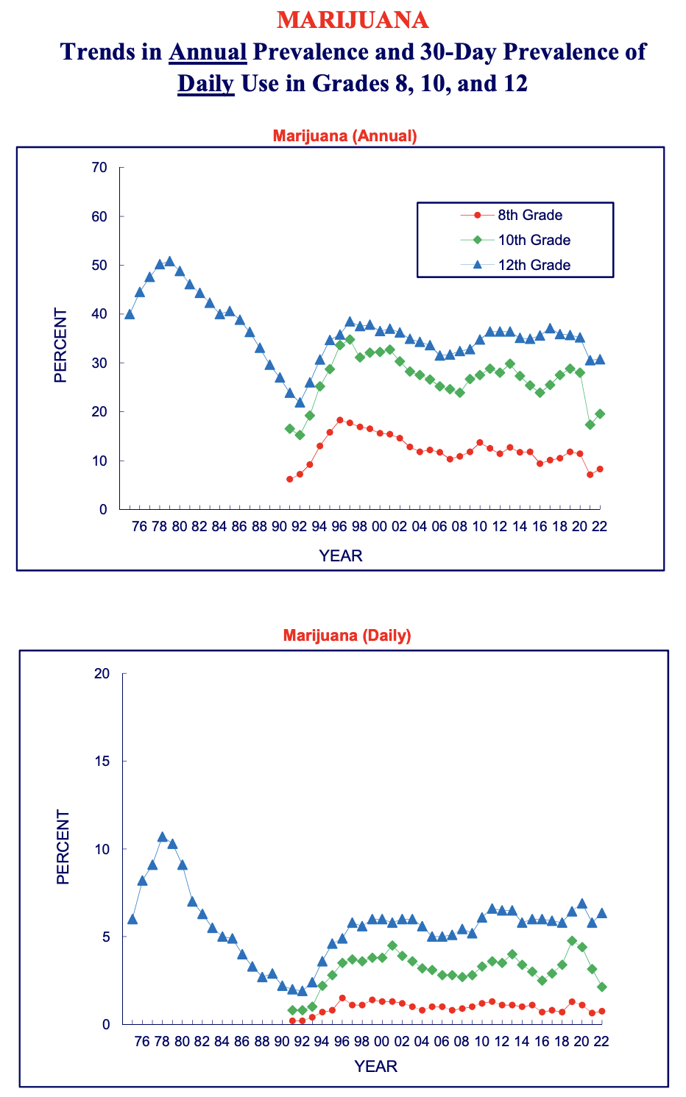
TRENDS IN ANNUAL AND
PAST 30D PREVALENCE OF USE
Notes:
Yet, interestingly, overall prevalence hasn’t skyrocketed—A number of explanation why this might be the case…

Slide 10
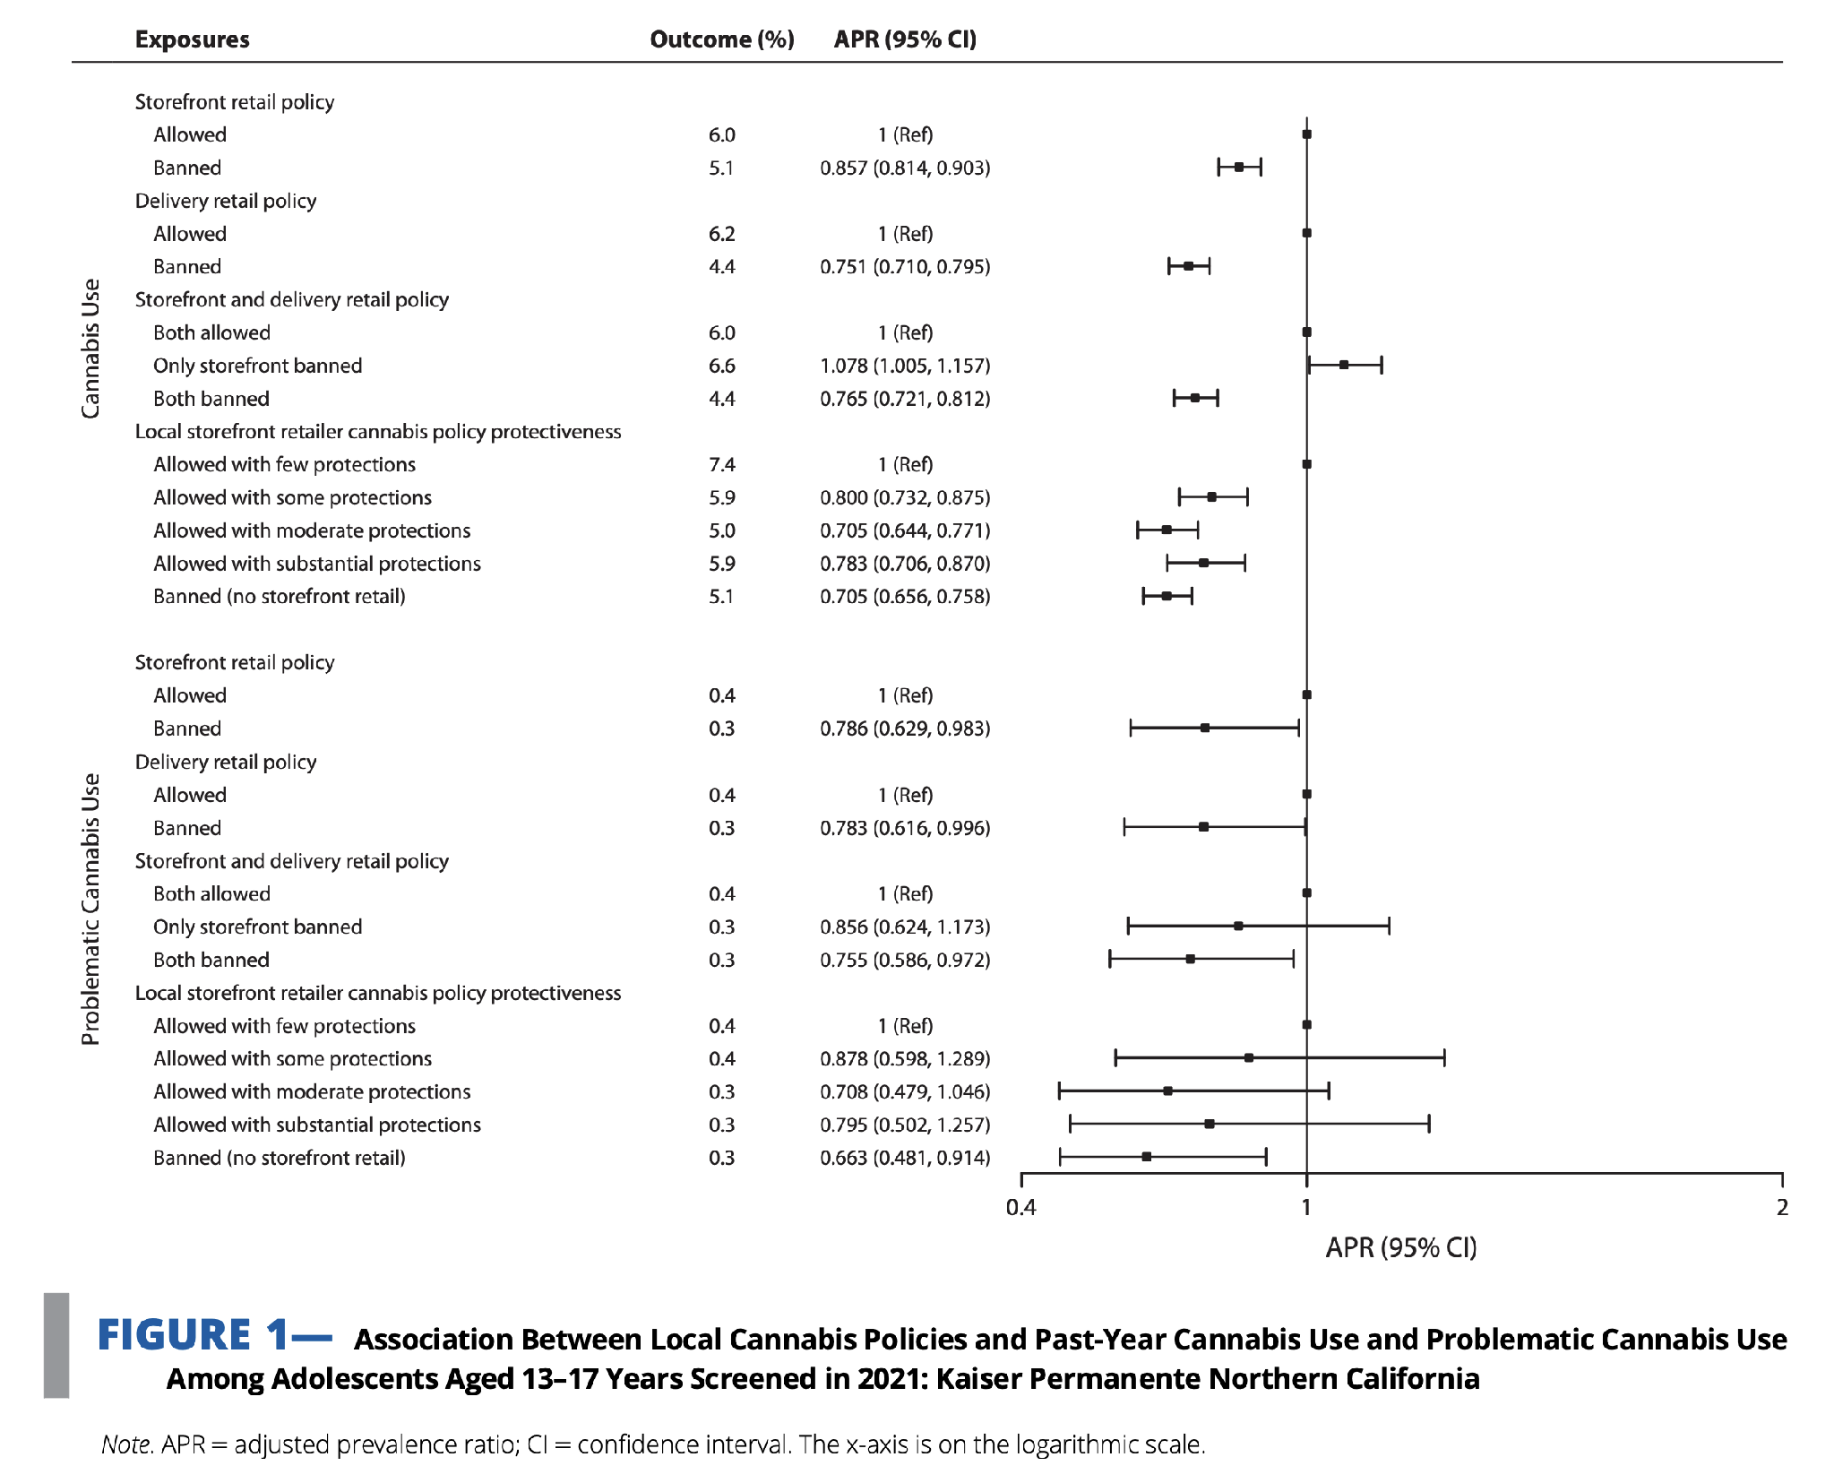
DIFFERENCES B Y LOCAL ACCESS
Young-Wolff et al., 2024, AJPH
Notes:
Yet, interestingly, overall prevalence hasn’t skyrocketed—A number of explanation why this might be the case…

Slide 11
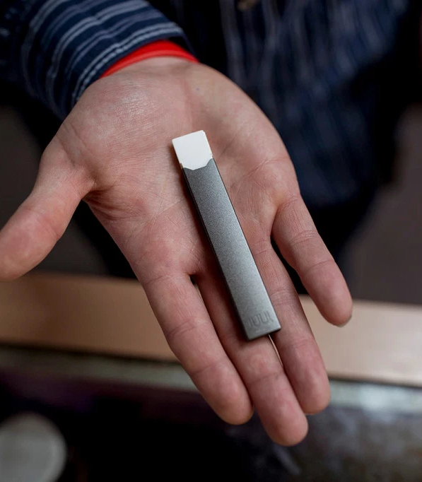

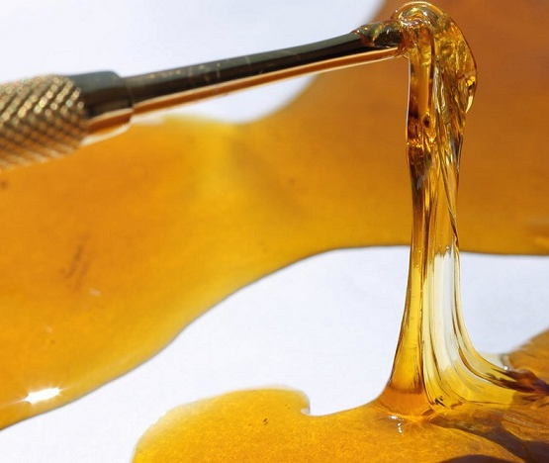
Notes:
Epi estimates are also not revealing changing patterns in entrenchment of use…i.e., among kids who are using, how much are they using

Slide 12
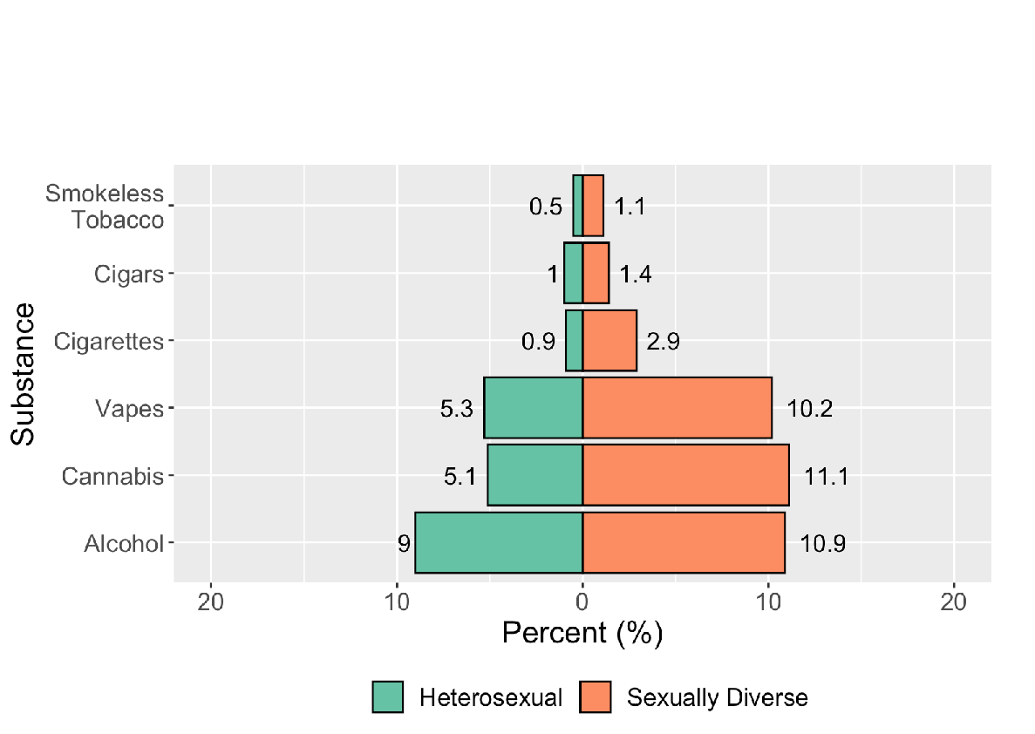
DISPARITIES IN USE
MGH SURF SURVEY, UNPUBLISHED
Notes:
Epi estimates are also not revealing changing patterns in entrenchment of use…i.e., among kids who are using, how much are they using

Slide 13
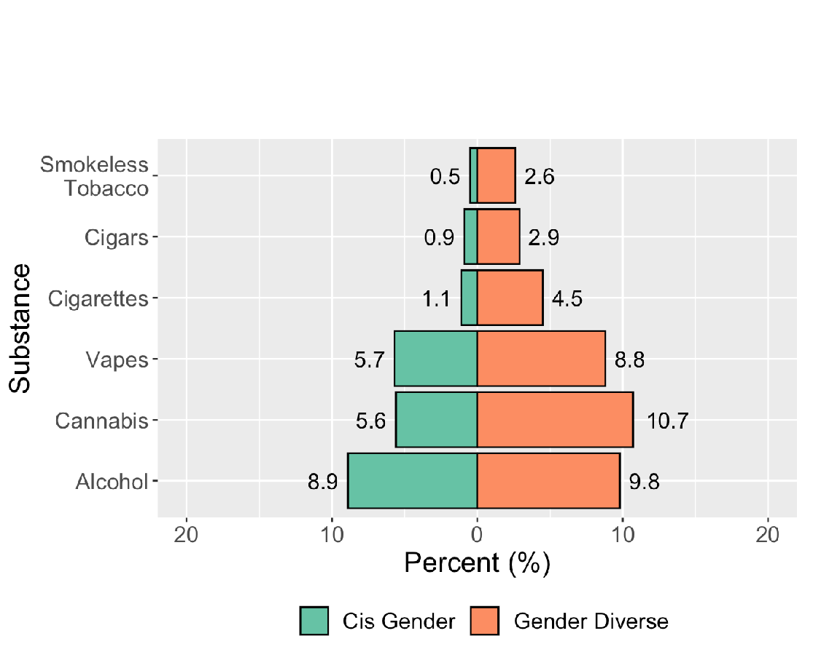
DISPARITIES IN USE
MGH SURF SURVEY, UNPUBLISHED
Notes:
Epi estimates are also not revealing changing patterns in entrenchment of use…i.e., among kids who are using, how much are they using

Slide 14
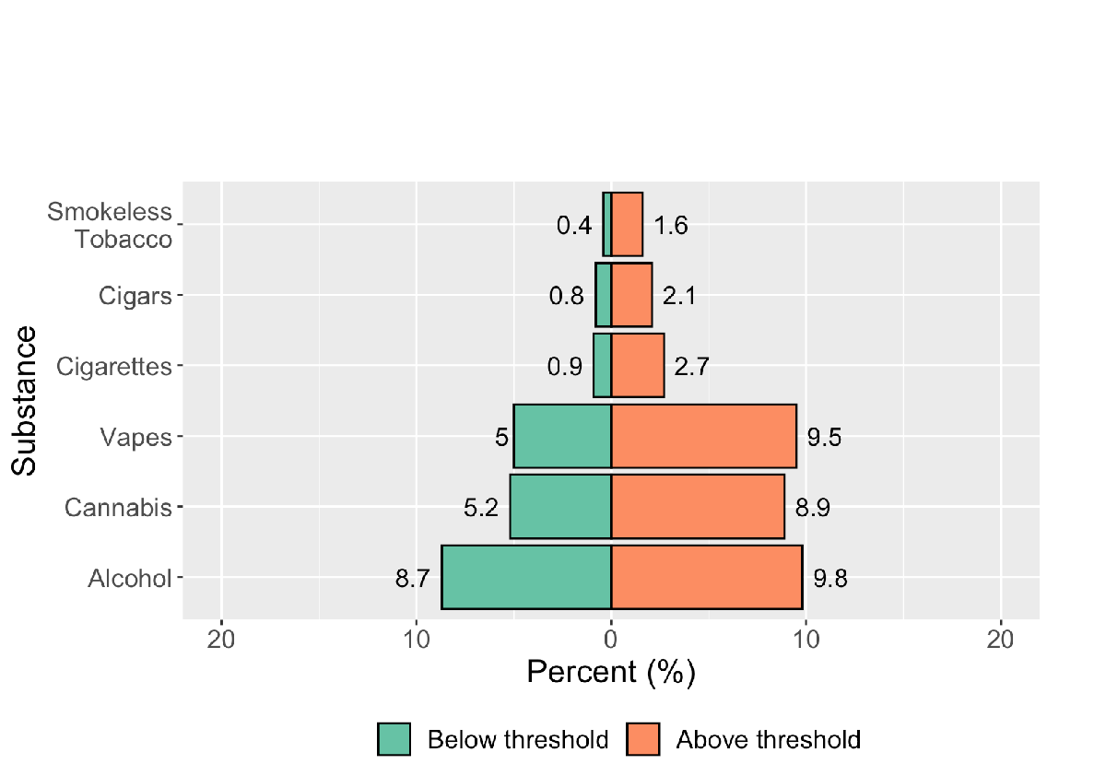
DISPARITIES IN USE
MGH SURF SURVEY, UNPUBLISHED
Notes:
Epi estimates are also not revealing changing patterns in entrenchment of use…i.e., among kids who are using, how much are they using

Slide 15
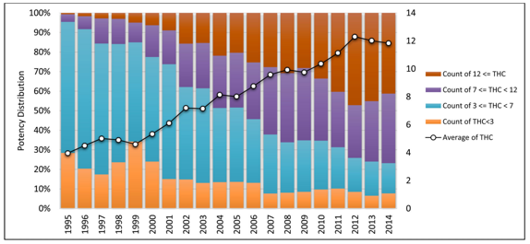
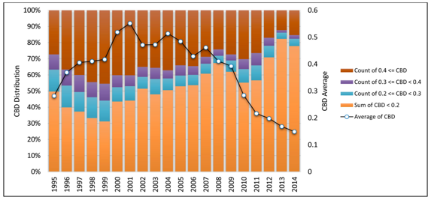
RISING POTENCIES
ElSohly et al., 2016, Biological Psychiatry
Notes:
Potency has more than tripled in the past two decades
This figure shows on the left rising rates of delta-9-thc over time – the primary constituent of the cannabis plant responsible for the intoxicating effects the prime culprit of purported residual harm

Slide 16
Novel forms of THC delivery are the new norm, yet use is difficult to detect and we have very little information on long-term effects.
Notes:
Potency has more than tripled in the past two decades
This figure shows on the left rising rates of delta-9-thc over time – the primary constituent of the cannabis plant responsible for the intoxicating effects the prime culprit of purported residual harm

Slide 17

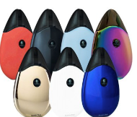



Other vape devices
Notes:
Potency has more than tripled in the past two decades
This figure shows on the left rising rates of delta-9-thc over time – the primary constituent of the cannabis plant responsible for the intoxicating effects the prime culprit of purported residual harm

Slide 18
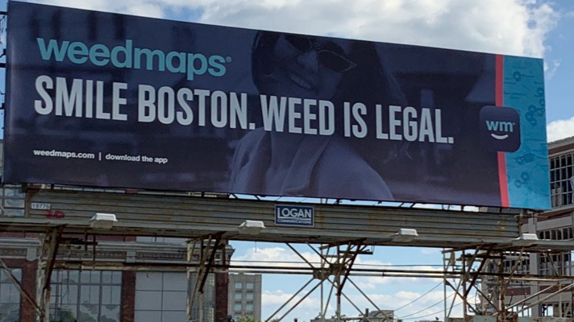
THIS IS HAPPENING AGAINST A SOCIETAL BACKDROP THAT IS INCREASINGLY PERMISSIVE OF USE...
Notes:
Potency has more than tripled in the past two decades
This figure shows on the left rising rates of delta-9-thc over time – the primary constituent of the cannabis plant responsible for the intoxicating effects the prime culprit of purported residual harm

Slide 19


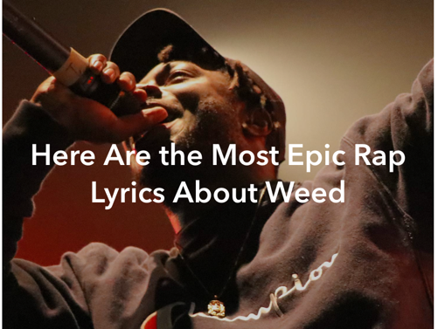
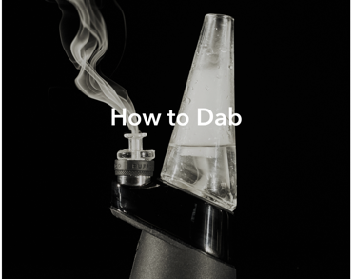

…with marketing geared toward attracting young users.
Notes:
Potency has more than tripled in the past two decades
This figure shows on the left rising rates of delta-9-thc over time – the primary constituent of the cannabis plant responsible for the intoxicating effects the prime culprit of purported residual harm

Slide 20
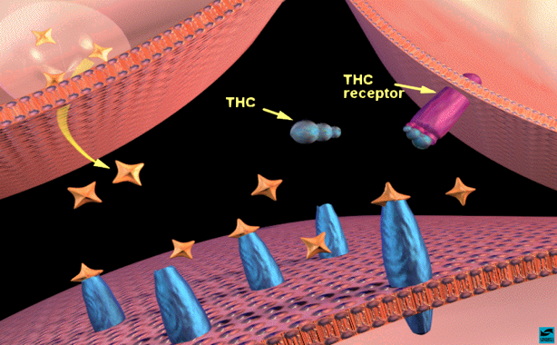
>200 PHYTOCANNABINOIDS IN THE CANNABIS PLANT
Δ9-tetrahydrocannabinol (THC)
  Agonist on endogenous cannabinoid receptors in the central (CB1) and peripheral (CB2) nervous system
  > affinity than endogenous ligand, anandamide
  Euphoric effect comes from THC
  Lipophilic and crosses the BBB and placenta
    Prenatal exposure 🡪 hyperactivity, impulsivity and inattention symptoms in childhood
    Elimination half-life of days-weeks
Other cannabinoids (e.g., CBD) that do not cause intoxication
  More commonly discussed when speculating about treatment of neurologic disease (e.g., epilepsy)
Eddy, 2010; NIDA, 2012a, 2012b; El Sohly et al., 2014; Goldschmidt, et al 2000

Slide 21
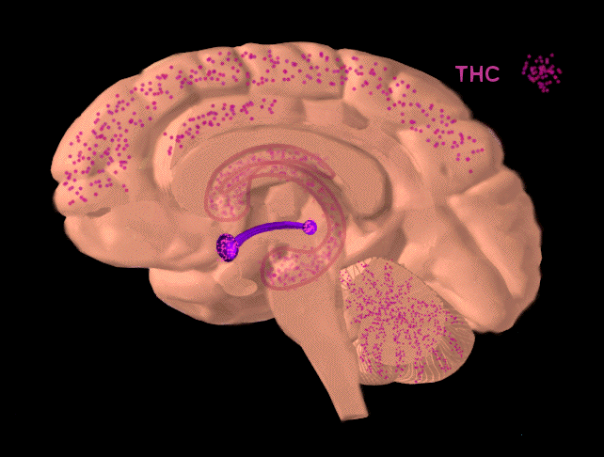
BROAD DISTRIBUTION OF THC BINDING SITES

Slide 22
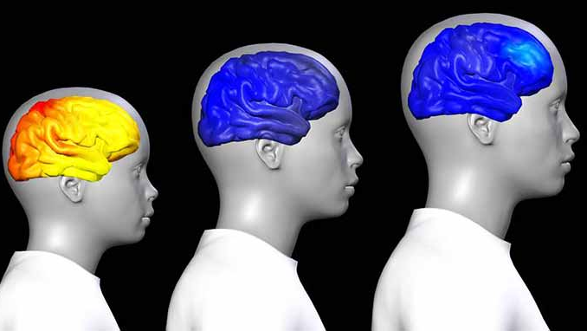
Ongoing brain development makes teenage use particularly risky.

Slide 23
ACUTE EFFECTS OF CANNABIS ARE WELL PROFILED
Typically peaks 30 minutes after inhalation and 2-4 hours after ingestion
+: Relaxation, euphoria, heightened perception, sociability, sensation of time slowing, increased appetite, decreased pain
-: Paranoia, anxiety, irritability, impaired short-term memory, poor attention and judgment, and poor coordination and balance, tachycardia, hypertension, dry mouth and throat
  Also 2-fold increased odds of respiratory symptoms among those who vape cannabis (Boyd et al., 2021)
↑ with THC content
Tolerance may occur but, effects typically still detectable
Broyd et al., 2106

Slide 24
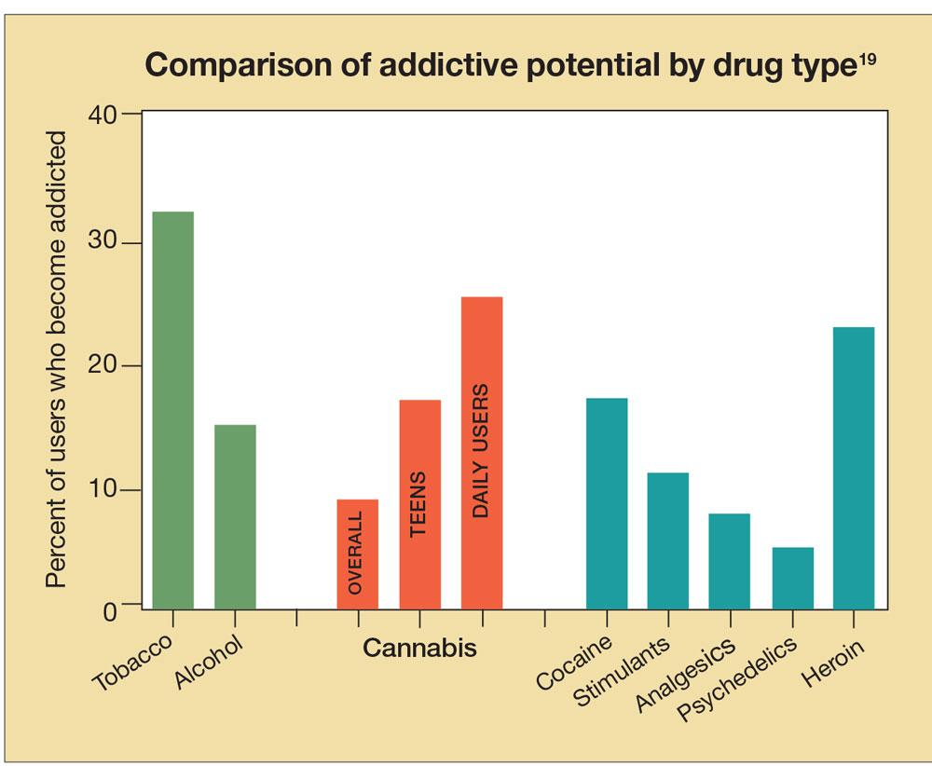
ADDICTION LIABILITY
4M people aged 12+ have a past year CUD
~23% of people who received addiction treatment received treatment for CUDs
Average adult entering tx for CUD has used daily for 10 years, tried to quit 6 times
Compton et al., 2004; NIDA, 2012a, 2012b; SAMHSA, 2012, 2017

Slide 25
SIGNS OF CANNABIS DEPENDENCE
Tolerance/withdrawal
  Anger or Aggression
  Decreased Appetite / Weight Loss
  Irritability
  Nervousness / Anxiety
  Restlessness
  Sleep Difficulties / Strange Dreams
Preoccupation
Loss of control
Continued use in the face of adverse consequences
Cognitive distortions/denial

Slide 26
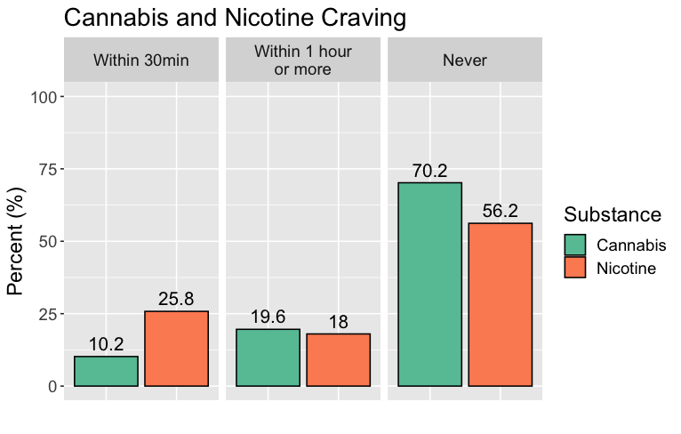

Slide 27
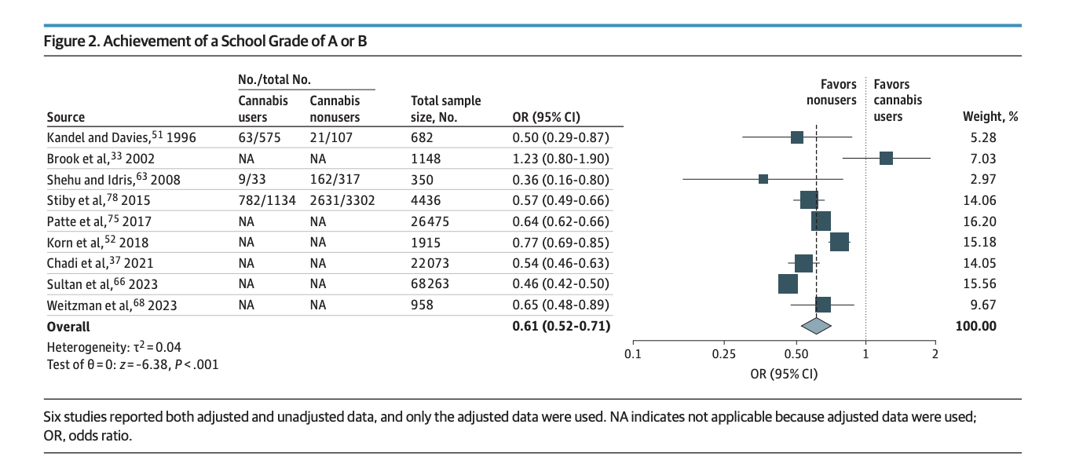
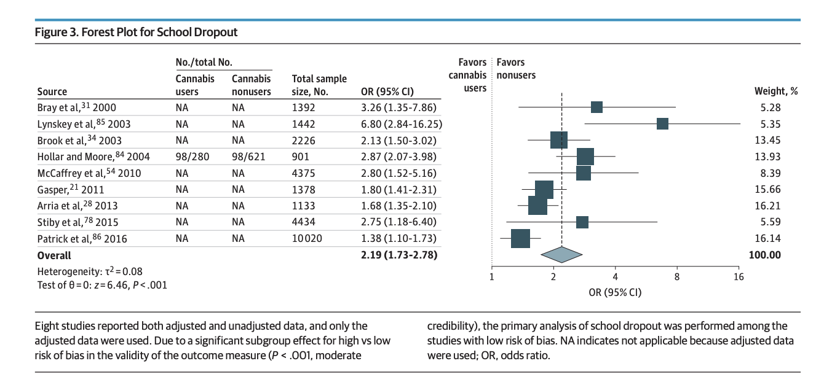
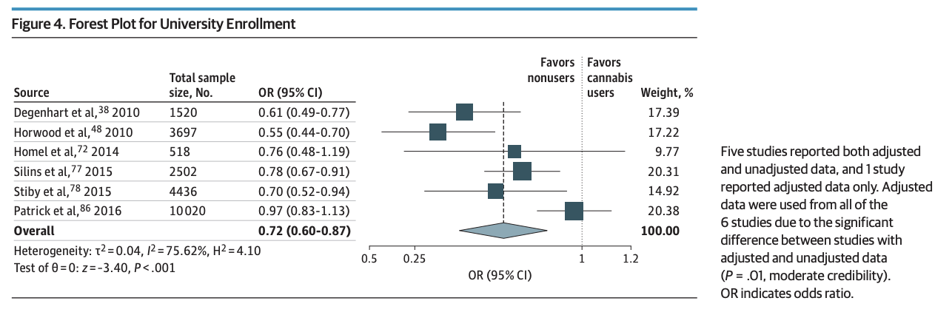
Cannabis Use During Adolescence and
Academic Achievement
Chan et al., 2024, JAMA Pediatrics

Slide 28
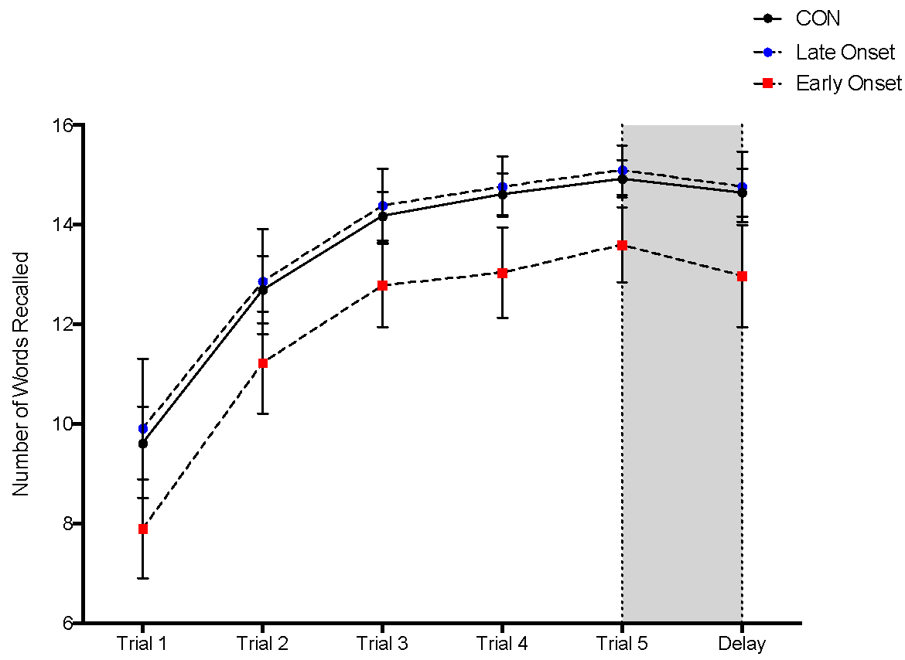
Differences in Encoding Across Five Learning Trials among Controls, Late Onset Marijuana Users and Early Onset Marijuana Users
Learning improved with repetition, with no group effect on the learning slope
Early users learned < words overall than late onset users or CON; Late onset = controls
No differences in percent retention
Early users used < overall learning strategies and < semantic clustering than controls
Schuster, Hoeppner, Evins & Gilman, Neuropsychology 2016

Slide 29
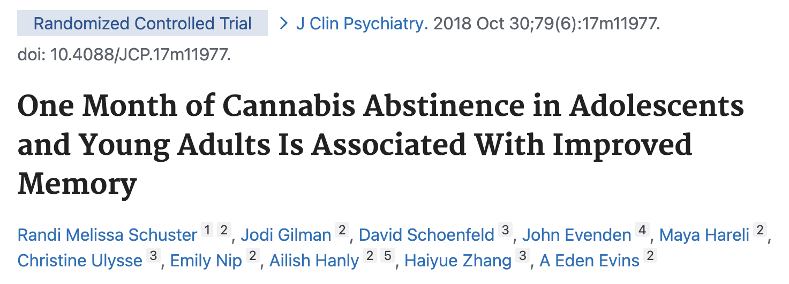
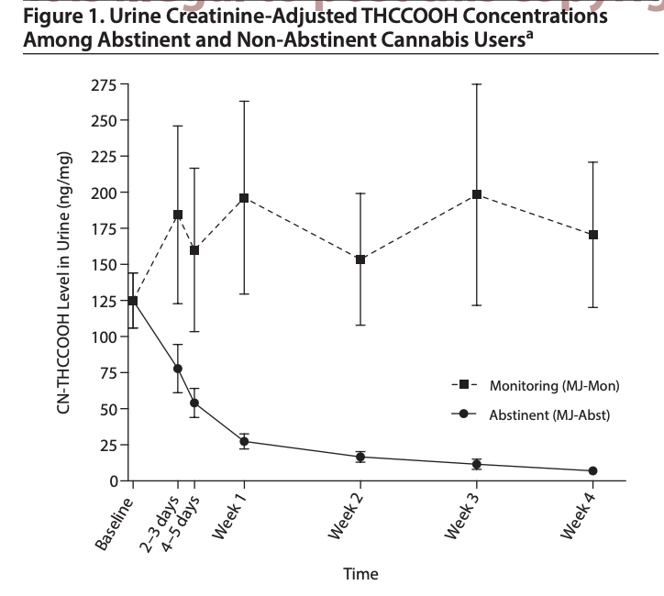
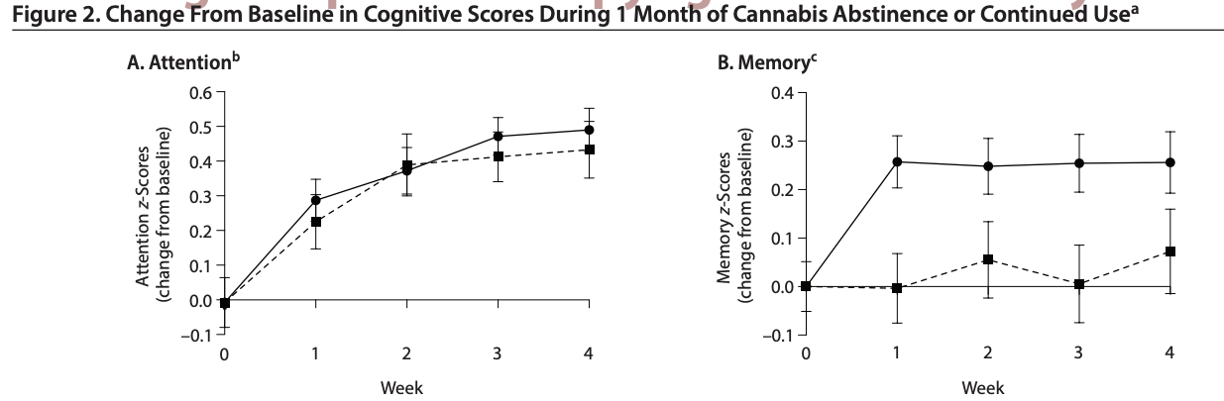
NEUROCOGNITIVE RECOVERY
WITH CANNABIS ABSTINENCE

Slide 30
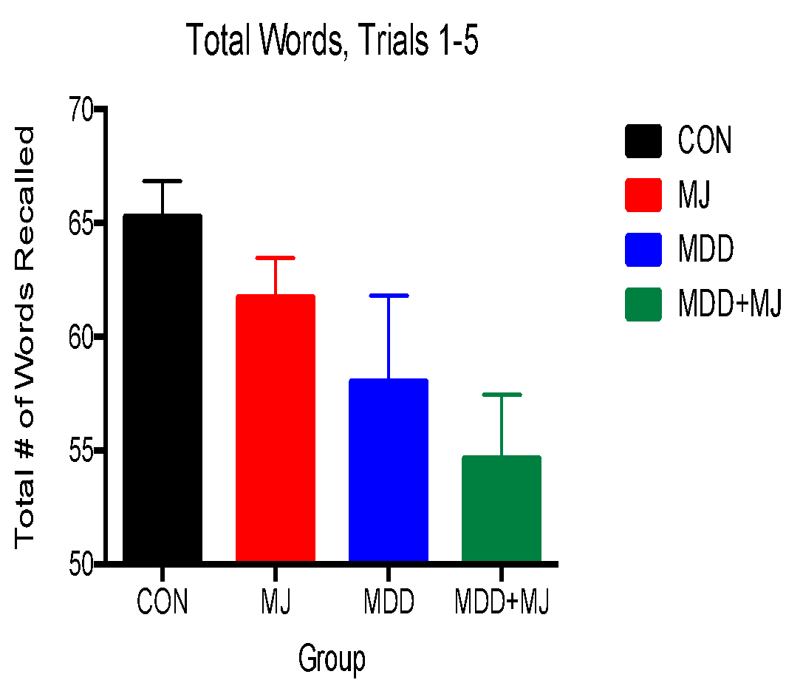
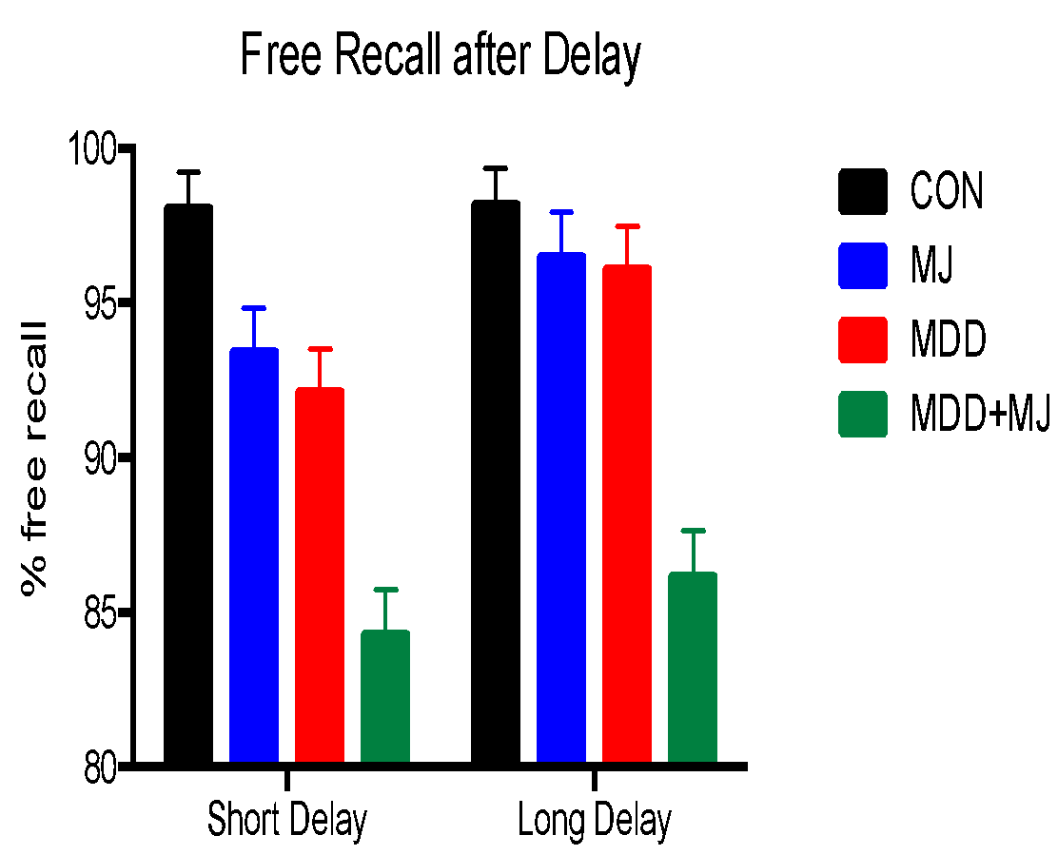
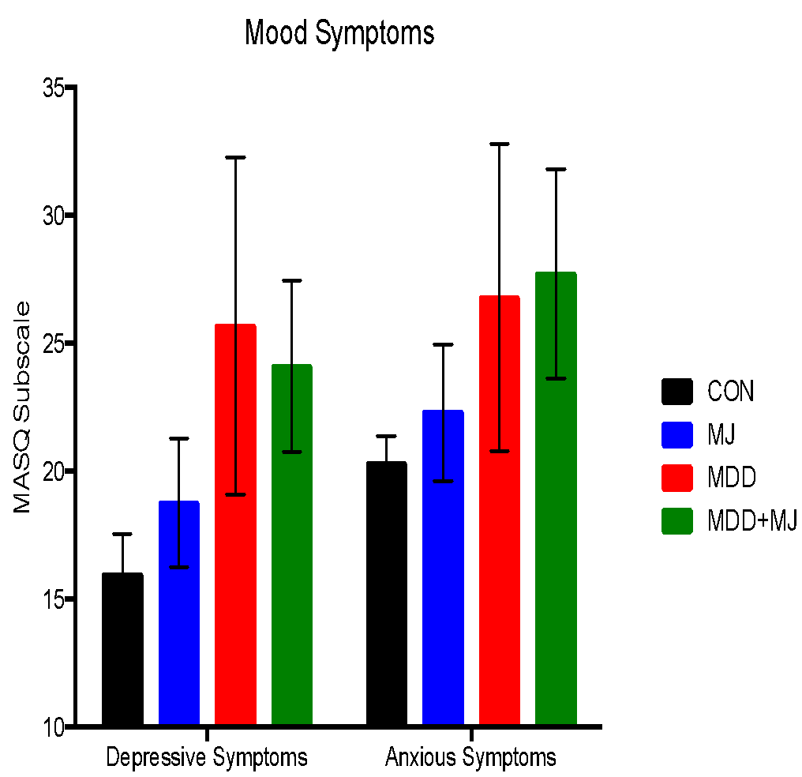
GREATER VULNERABILITY WITH PSYCHIATRIC DIAGNOSES?
Radoman et al., 2019

Slide 31

Notes:
This study will characterize the proximal effects of acute cannabis use and withdrawal on depressive symptoms and SI across 3 waves of intensive longitudinal monitoring among cannabis using adolescents with depression and past-month SI (N=200). The first wave of EMA will occur for 2-weeks during baseline cannabis use. We will then use a prospective design, randomizing participants to 8 weeks of incentivized abstinence or monitoring, with a 1-week EMA phase at weeks 1 and 8 post-randomization. To impact rising rates of youth depression and suicide, we aim to characterize time-varying relationships between cannabis use and withdrawal on depressive symptoms and SI in a high-risk population, and to identify when, why, and for whom acute cannabis use and withdrawal confer proximal risk for exacerbation of mood and SI.

Slide 32
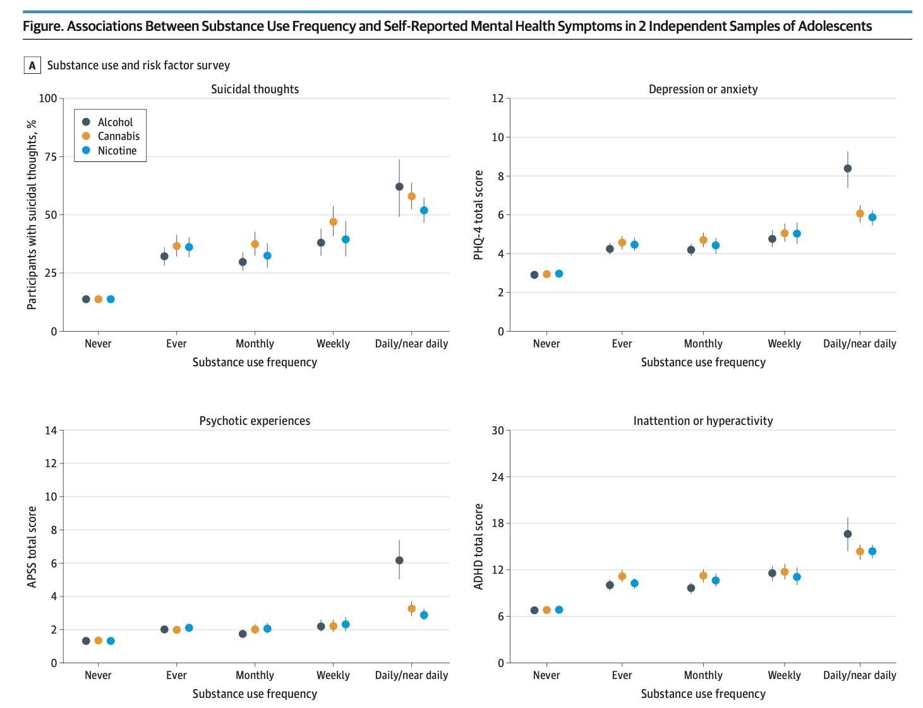
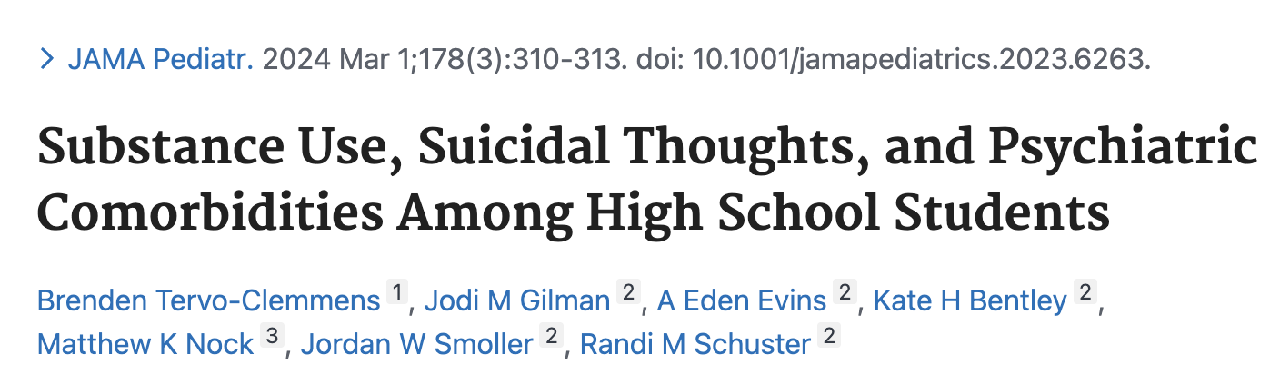
SUBSTANCE USE AND PSYCHIATRIC CO-MORBIDITIES
Notes:
This study will characterize the proximal effects of acute cannabis use and withdrawal on depressive symptoms and SI across 3 waves of intensive longitudinal monitoring among cannabis using adolescents with depression and past-month SI (N=200). The first wave of EMA will occur for 2-weeks during baseline cannabis use. We will then use a prospective design, randomizing participants to 8 weeks of incentivized abstinence or monitoring, with a 1-week EMA phase at weeks 1 and 8 post-randomization. To impact rising rates of youth depression and suicide, we aim to characterize time-varying relationships between cannabis use and withdrawal on depressive symptoms and SI in a high-risk population, and to identify when, why, and for whom acute cannabis use and withdrawal confer proximal risk for exacerbation of mood and SI.

Slide 33
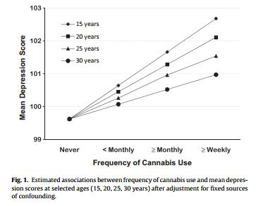
RATES OF COMORBIDITY GREATER THAN CHANCE
Depressed patients more likely to use cannabis
Cannabis users more likely to have to depression
  ICD-10 depressive illness was nearly 4X higher among those with a cannabis use disorder, compared to those without a depressive illness
Many longitudinal studies show this relationship even after controlling for confounding variables
Among patients with MDD, cannabis is associated with:
  ↑ anhedonia, change in body weight, insomnia or hypersomnia, and psychomotor agitation or retardation
  More symptoms
  ↑ depressive episodes
  Treatment failure
Feingold et al., 2015; Grant et al., 2004; Martins & Gorelick, 2011; Nesvag et al., 2015; Patten et al., 2015; Smolkina et al., 2017; Horwood et al., 2012
Notes:
This study will characterize the proximal effects of acute cannabis use and withdrawal on depressive symptoms and SI across 3 waves of intensive longitudinal monitoring among cannabis using adolescents with depression and past-month SI (N=200). The first wave of EMA will occur for 2-weeks during baseline cannabis use. We will then use a prospective design, randomizing participants to 8 weeks of incentivized abstinence or monitoring, with a 1-week EMA phase at weeks 1 and 8 post-randomization. To impact rising rates of youth depression and suicide, we aim to characterize time-varying relationships between cannabis use and withdrawal on depressive symptoms and SI in a high-risk population, and to identify when, why, and for whom acute cannabis use and withdrawal confer proximal risk for exacerbation of mood and SI.

Slide 34
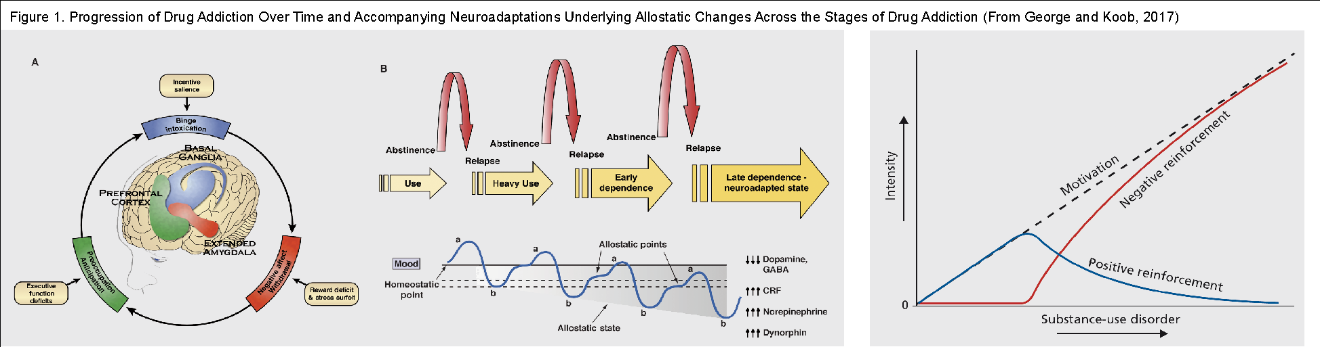
Why high rates of co-occurrence?
Negative reinforcement motivational theoretical model of addiction -- addiction may involve a transition from impulsive to compulsive behaviors and from positive to negative reinforcement over time
Notes:
This study will characterize the proximal effects of acute cannabis use and withdrawal on depressive symptoms and SI across 3 waves of intensive longitudinal monitoring among cannabis using adolescents with depression and past-month SI (N=200). The first wave of EMA will occur for 2-weeks during baseline cannabis use. We will then use a prospective design, randomizing participants to 8 weeks of incentivized abstinence or monitoring, with a 1-week EMA phase at weeks 1 and 8 post-randomization. To impact rising rates of youth depression and suicide, we aim to characterize time-varying relationships between cannabis use and withdrawal on depressive symptoms and SI in a high-risk population, and to identify when, why, and for whom acute cannabis use and withdrawal confer proximal risk for exacerbation of mood and SI.

Slide 35
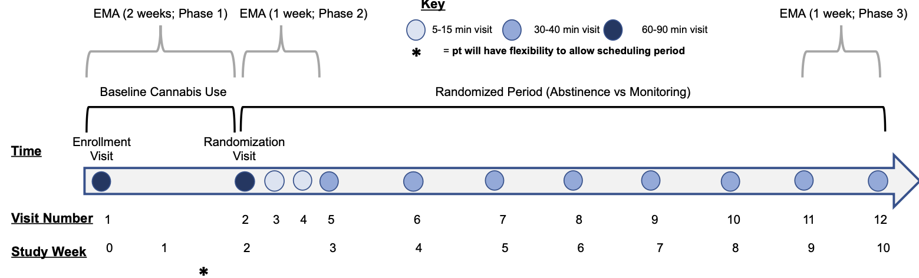
STUDY DESIGN
Notes:
This study will characterize the proximal effects of acute cannabis use and withdrawal on depressive symptoms and SI across 3 waves of intensive longitudinal monitoring among cannabis using adolescents with depression and past-month SI (N=200). The first wave of EMA will occur for 2-weeks during baseline cannabis use. We will then use a prospective design, randomizing participants to 8 weeks of incentivized abstinence or monitoring, with a 1-week EMA phase at weeks 1 and 8 post-randomization. To impact rising rates of youth depression and suicide, we aim to characterize time-varying relationships between cannabis use and withdrawal on depressive symptoms and SI in a high-risk population, and to identify when, why, and for whom acute cannabis use and withdrawal confer proximal risk for exacerbation of mood and SI.

Slide 36
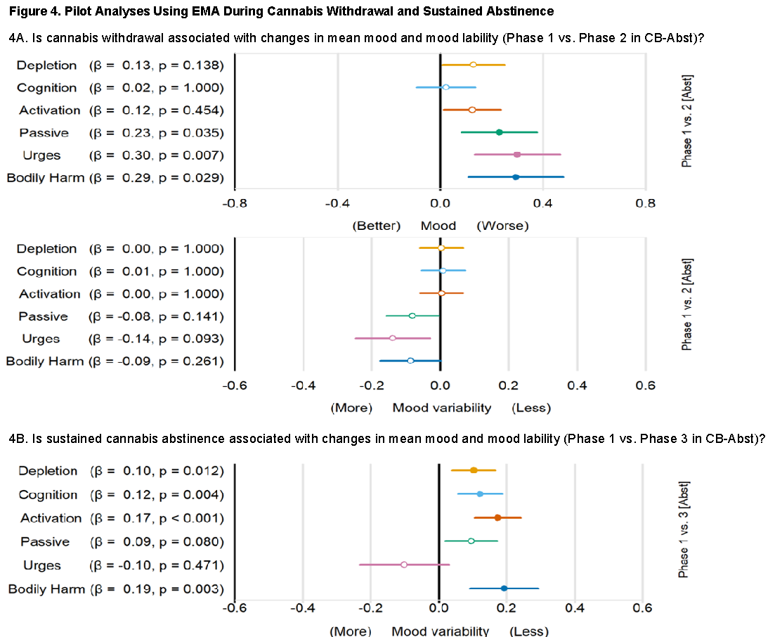
What Happens with Abstinence?

Slide 37

Need for schools to be mobilized to serve as the prevention hub of our mental health system
Schools are a critical access point to improve equity
  No-show rates for initial intake MH appointments range from 48-62%
  40-60% of children receiving outpatient MH services attend few sessions and drop out quickly
  Schools provide greater access to mental health services
Gopalan et al (2010); Harrison, McKay & Bannon (2004); Jaycox, 2009; McKay, McCadam, & Gonzales (1996); McKay, Lynn and Bannon (2005)

Slide 38
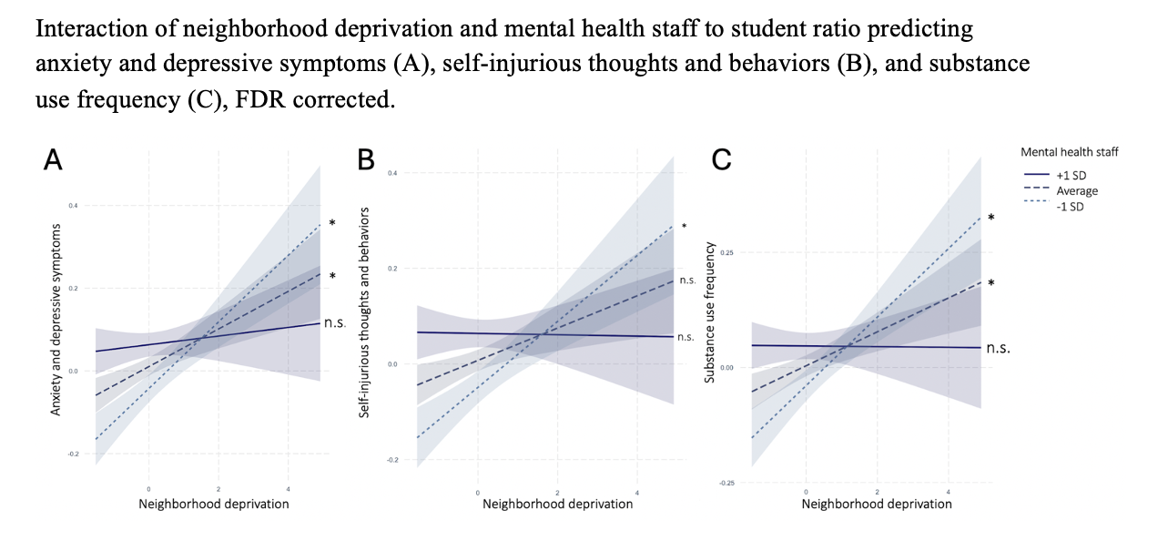
Vargas et al., JAACAP, 2025

Slide 39
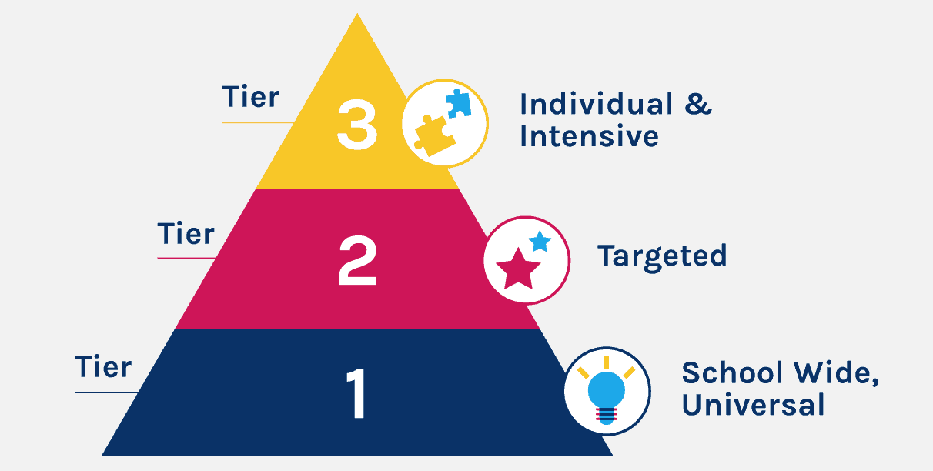

Structural

Slide 40
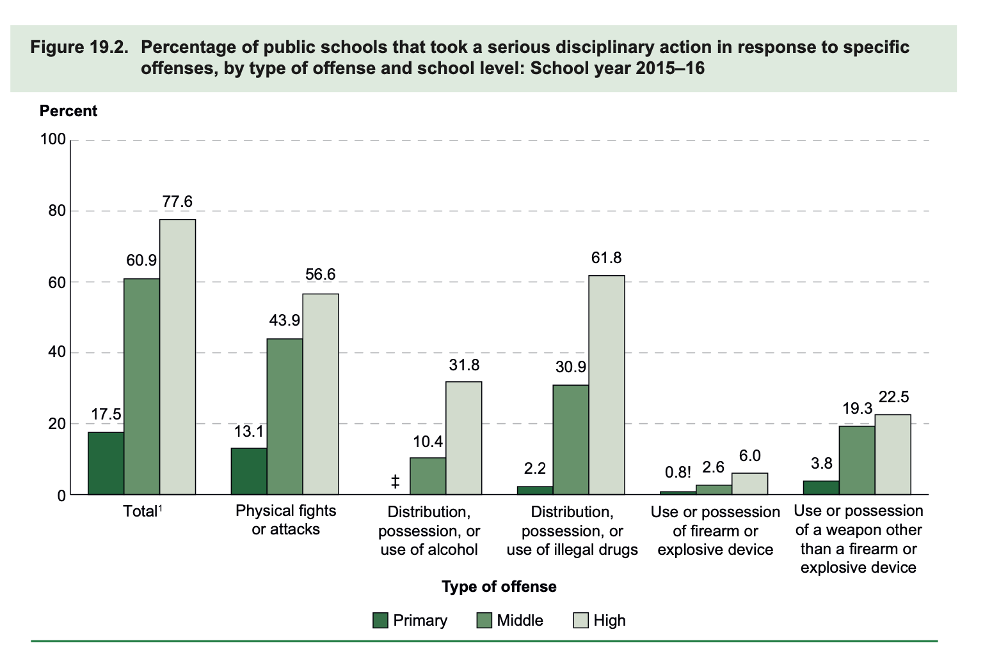
Alternatives to Punishment (Tier 2)
NCES, 2017
Notes:
Many school environments enforce policies that prohibit substance use on school campuses.
In fact by 1997, as a result of education policy mandates at federal, state, and local levels, 94% of public schools had adopted “zero tolerance” policies—perceived student misbehavior including substance use had mandated punitive consequences.
Punitive school discipline is a process that deploys surveillance (e.g., metal detectors and armed campus officers), restrictive (e.g.,restraint and seclusion), and exclusionary (e.g., removal from school) tactics to address substance use and other forms of perceived student misbehavior.
This figure is pulled from the National Center for Education and Statistics from their 2017 Indicators of School Crime and Safety report, and shows that 32% high schools report deploying serious disciplinary action related to alcohol use and 62% for other substances. Mind you this is right before the vaping epidemic surged in young people – 2015-2016 school year -- so likely a vast underestimate.
In MA, this past year, nearly 10k students disciplined for something having to do with substances
Indicators of School Crime and Safety: 2017. NCES 2018-036/NCJ 251413

Slide 41
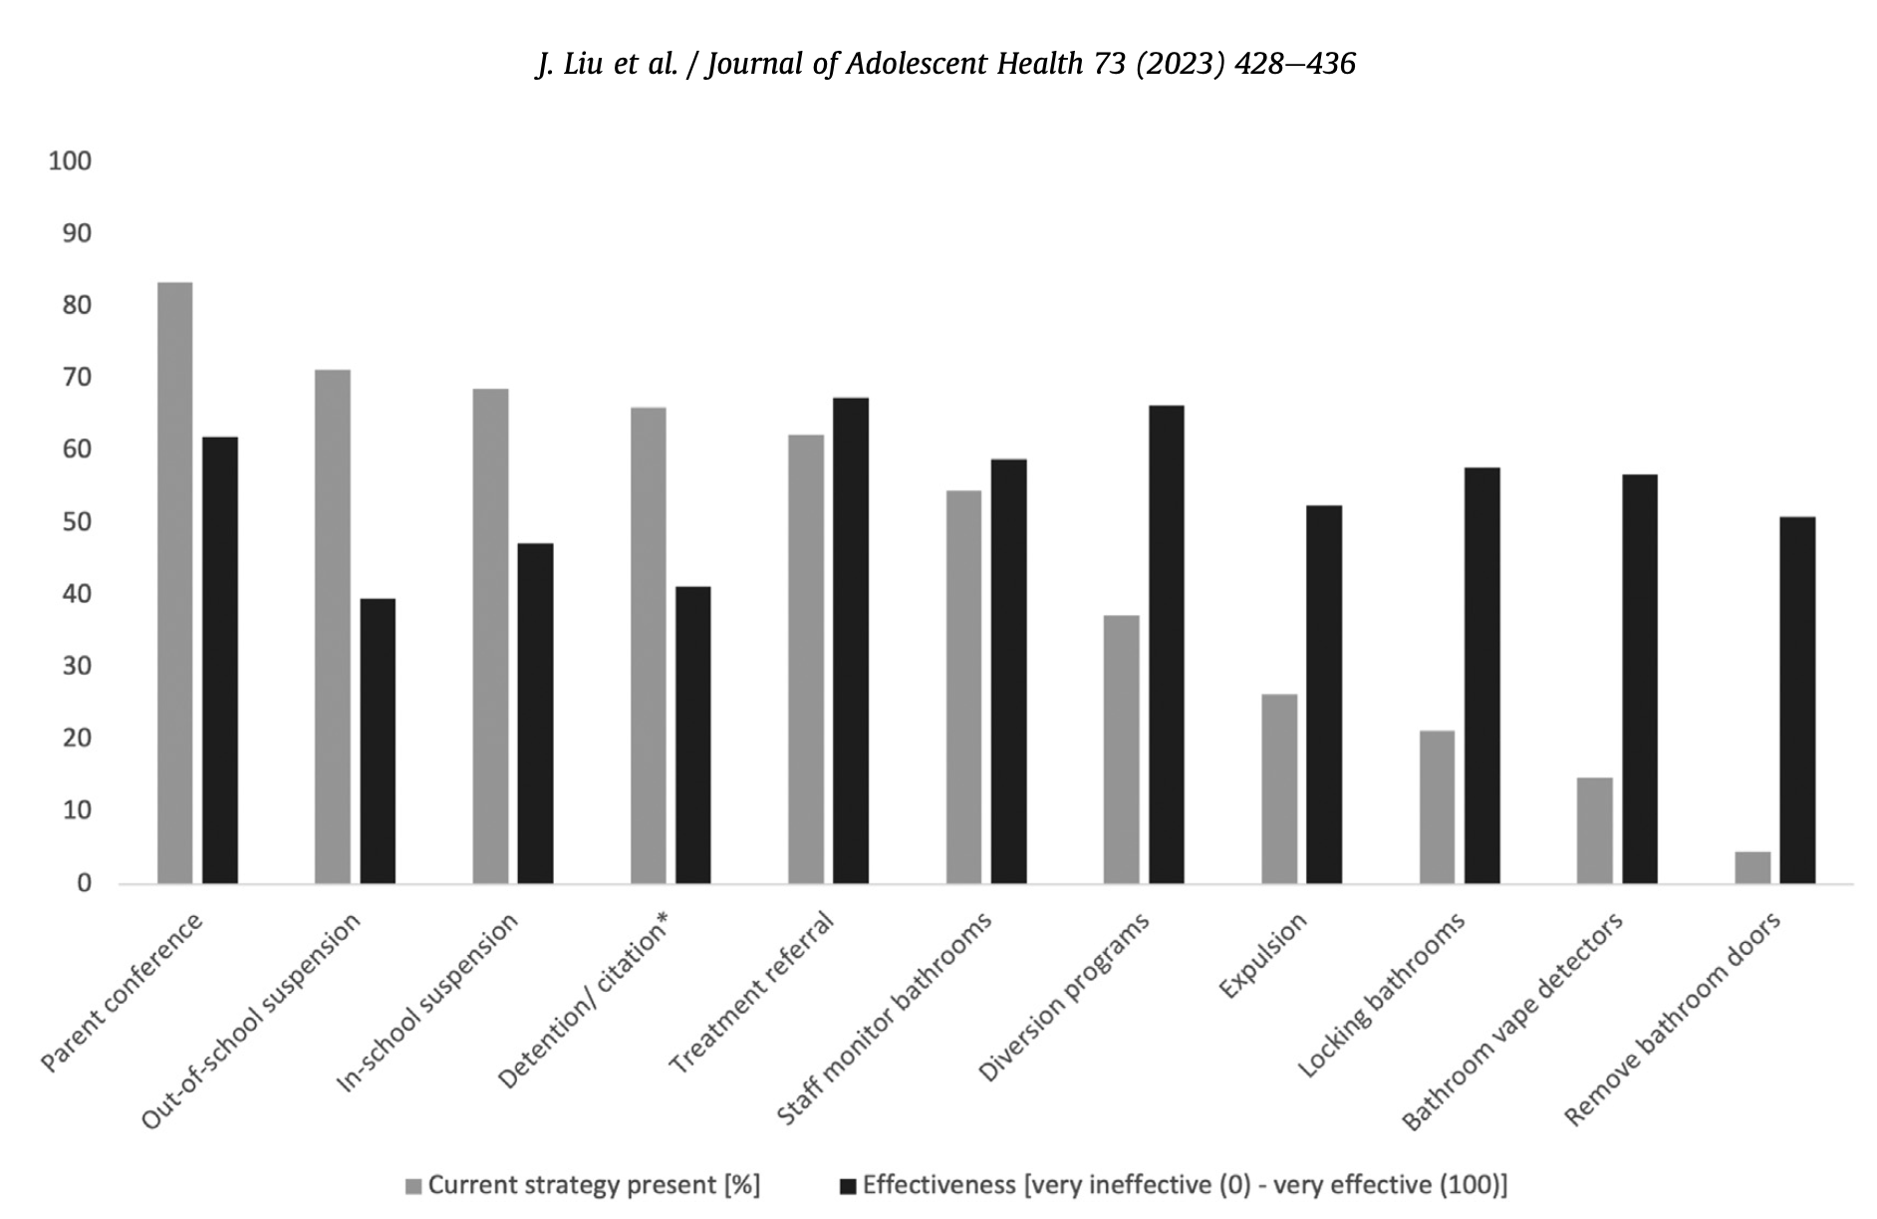
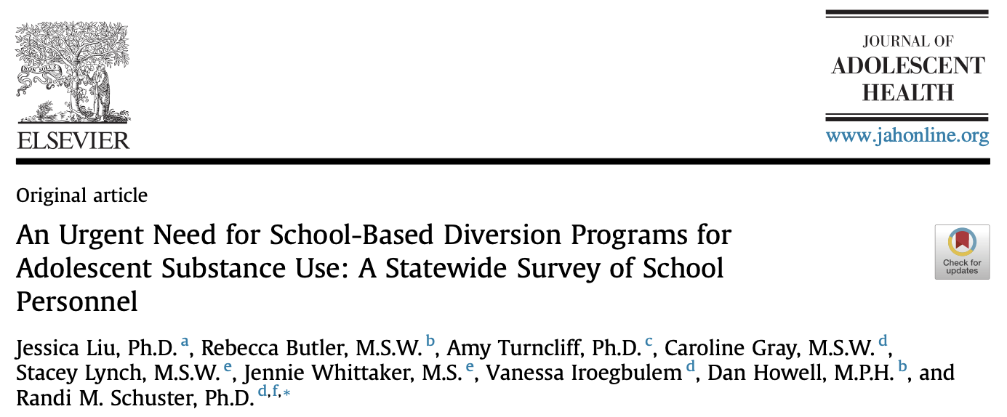
Alternatives to Punishment (Tier 2)

Slide 42
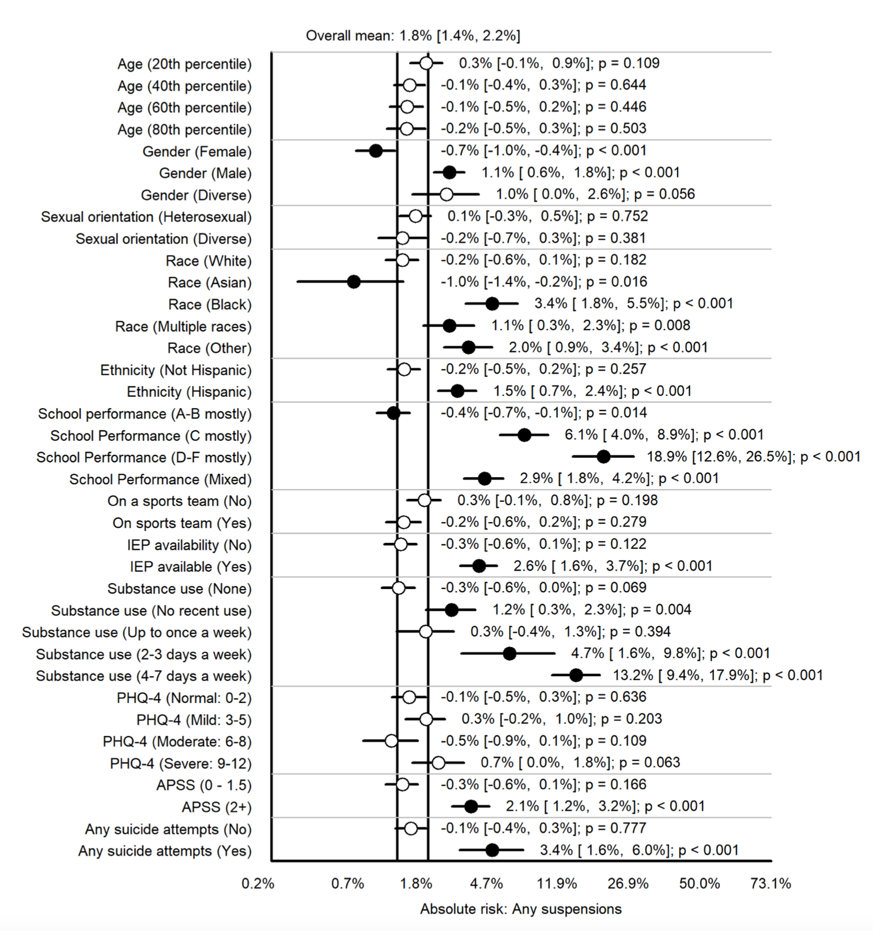
Characteristics of Students Suspended
OR_{male}=2.9
OR_{black}=5.2
OR_{+races}=2.9
Or_{other race}=3.8
OR_{Hispanic}=3.3
OR_{C grades}=7.9
OR_{D-F grades}=20.7
Or_{mixed grades}=4.7
OR_{IEP}=4.4
OR_{SU 2-3 days/week}=6.5
OR_{4-7 days/week}=15
OR_{APSS}=3.9
OR_{SI attempt}=5.2

Slide 43
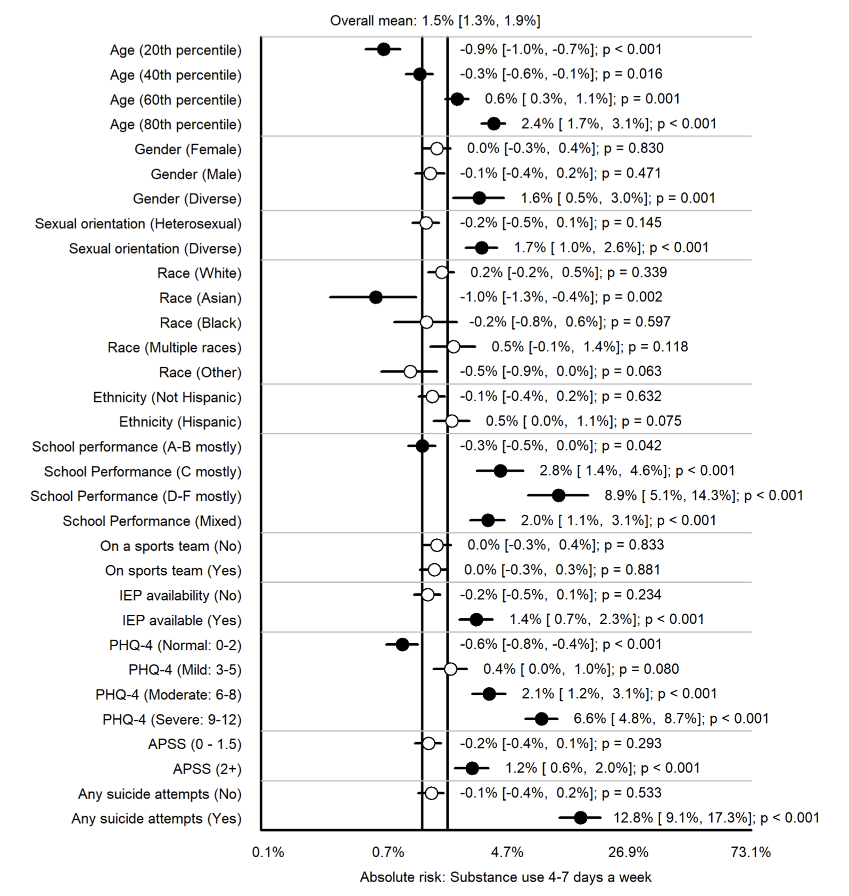
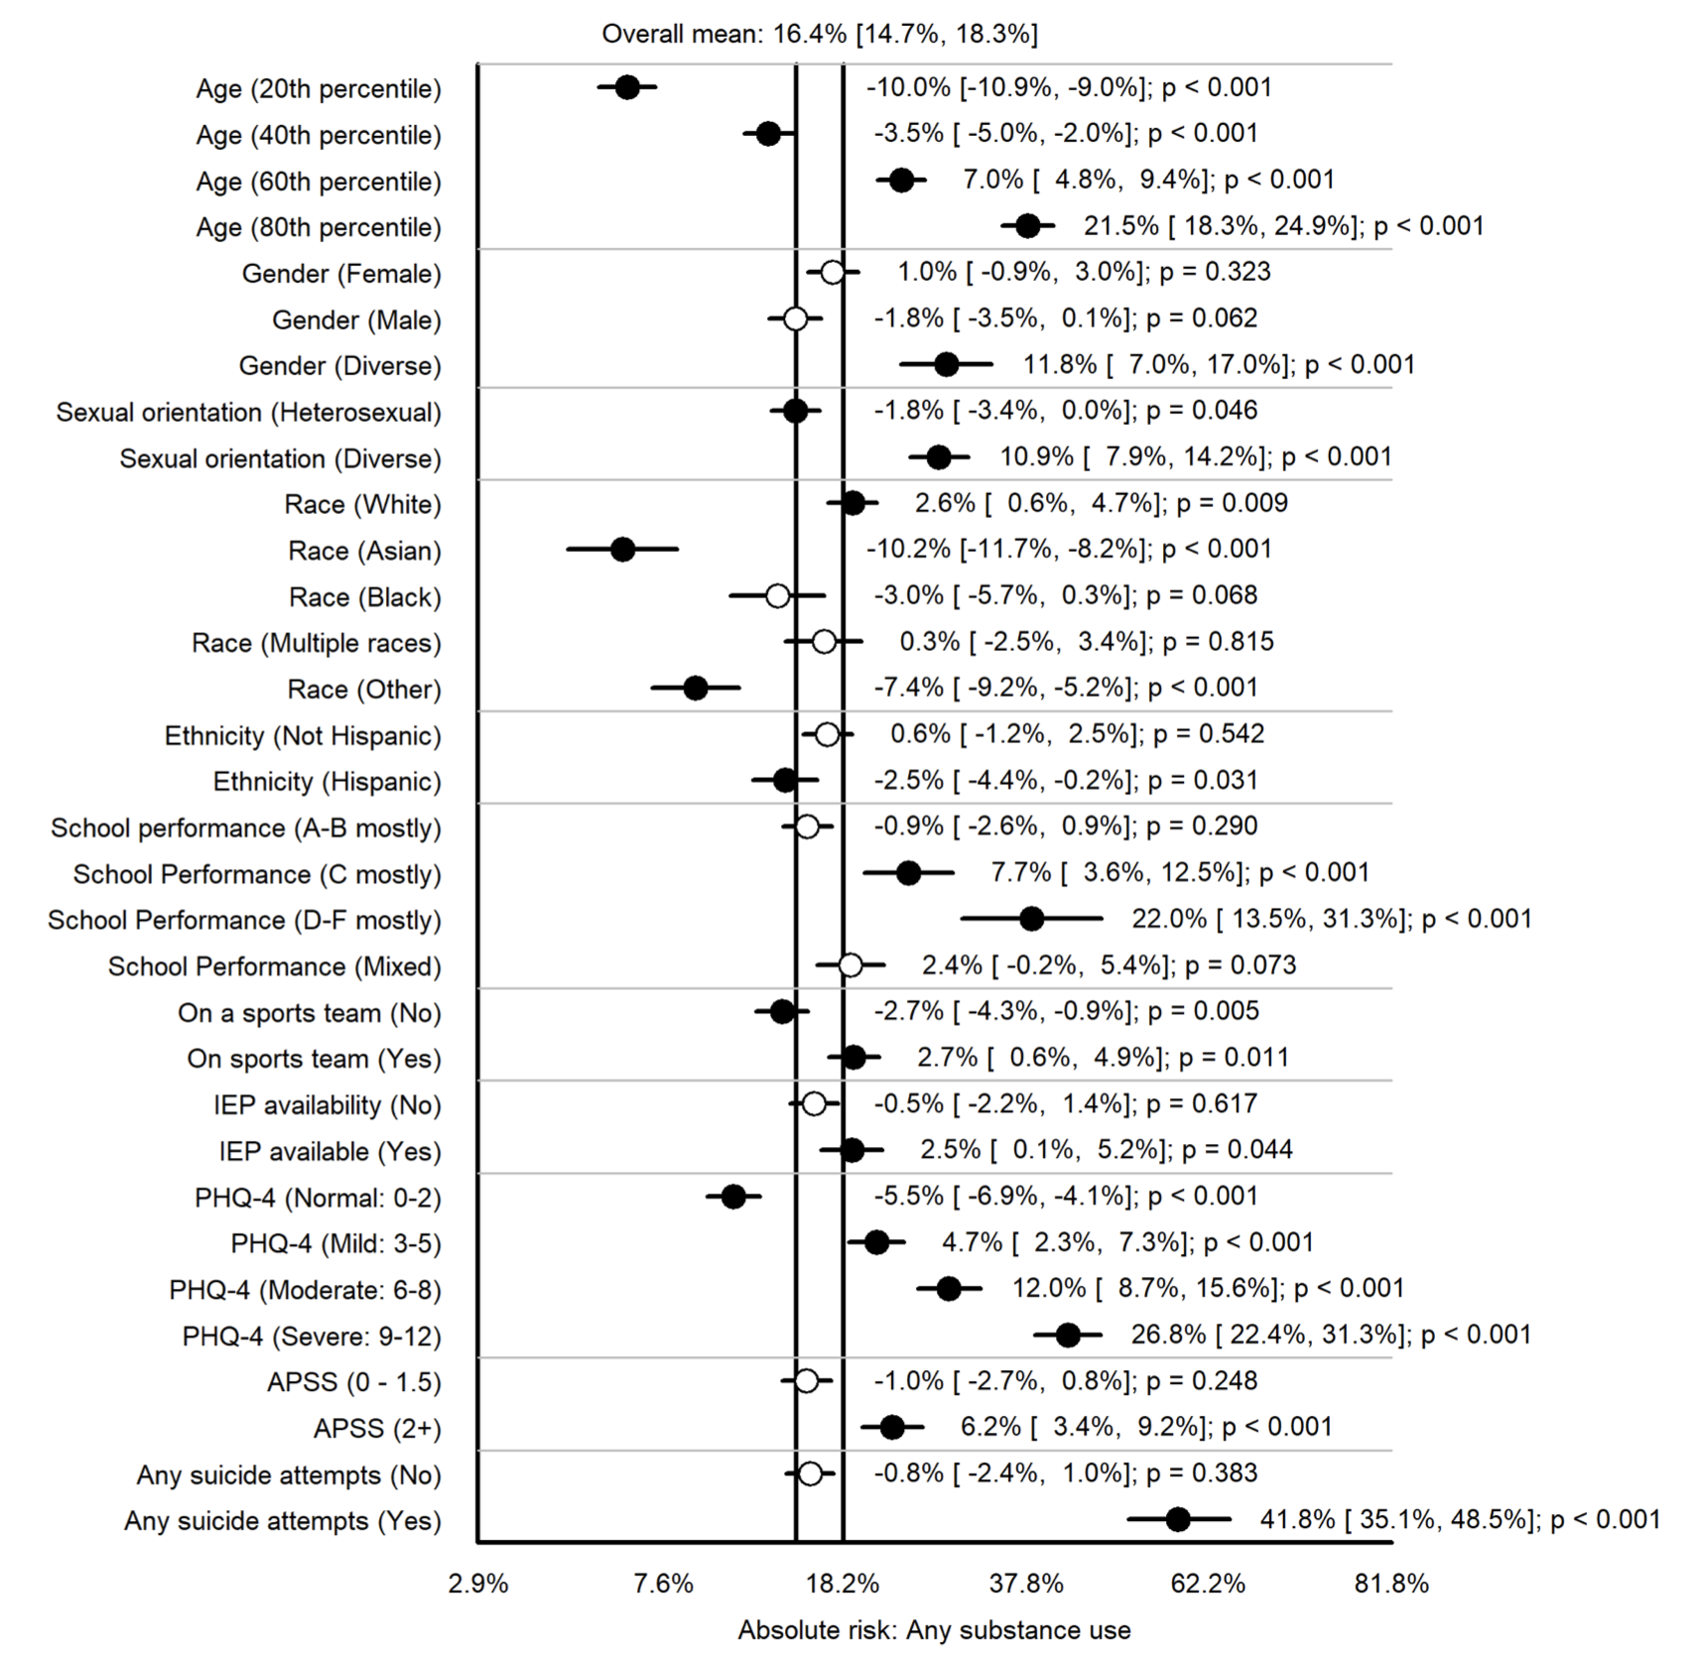
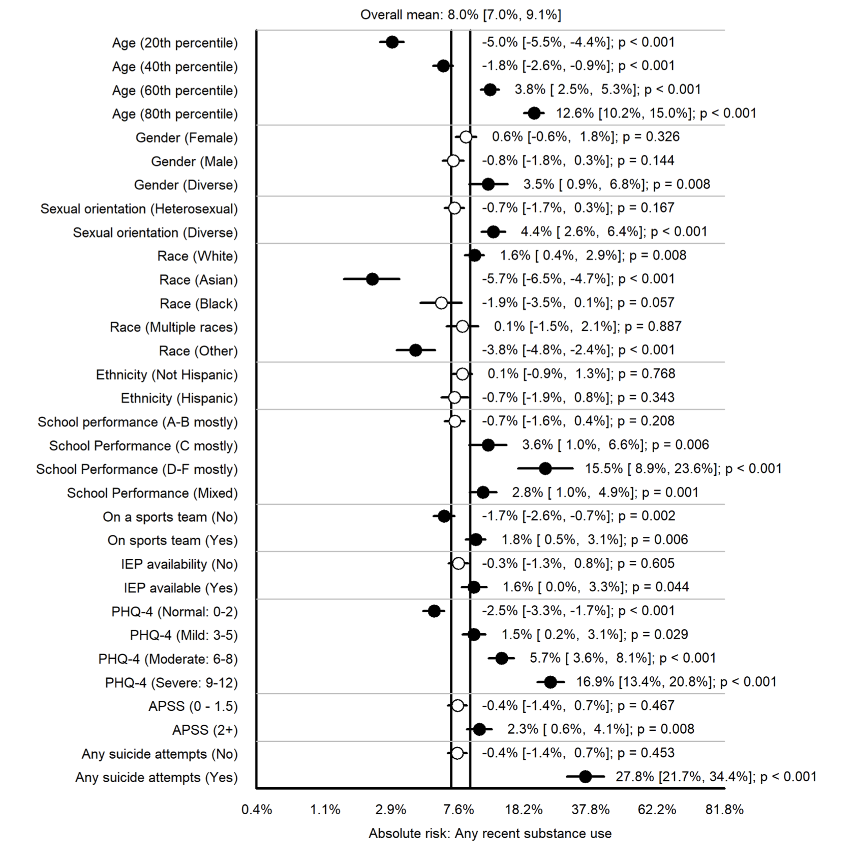

Slide 44
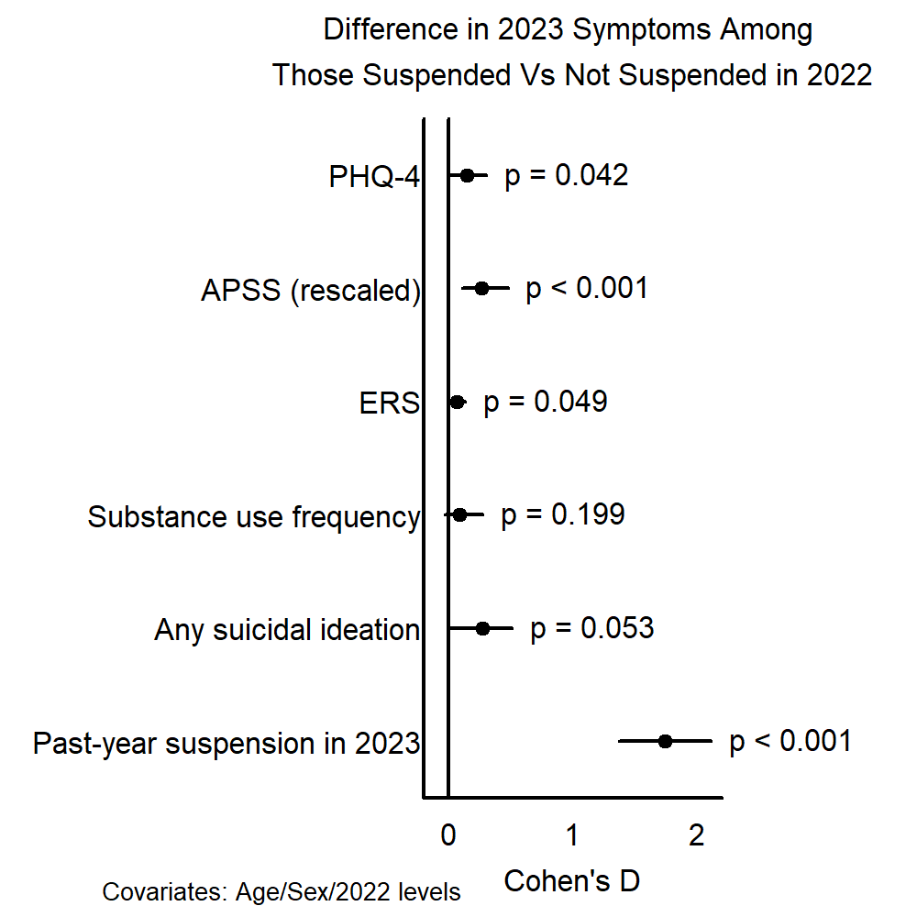
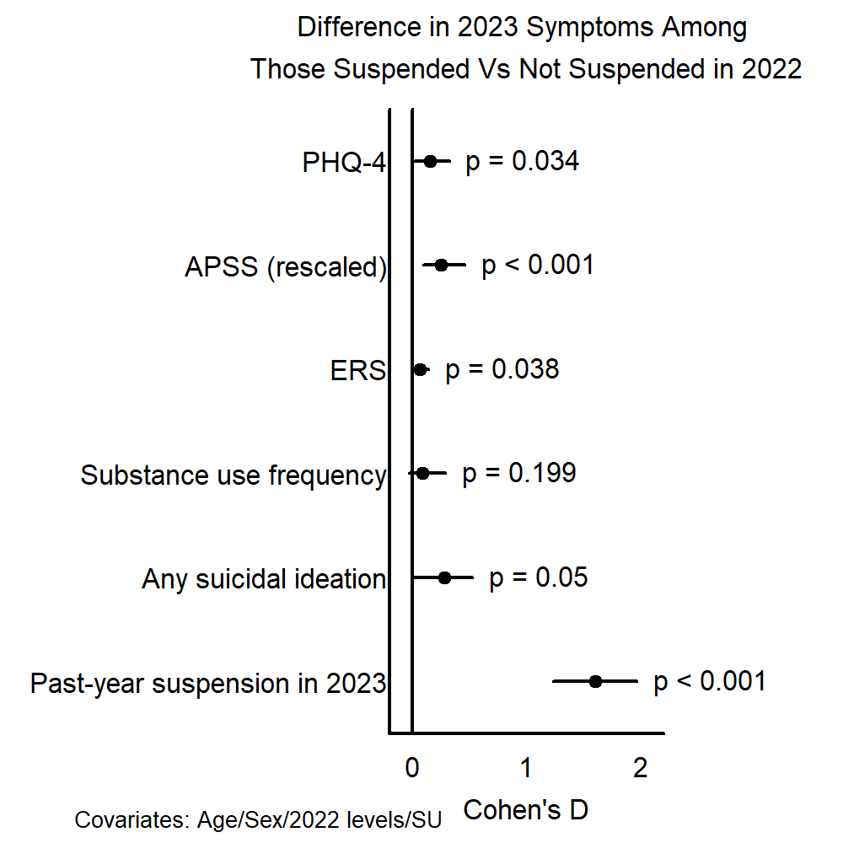

Slide 45




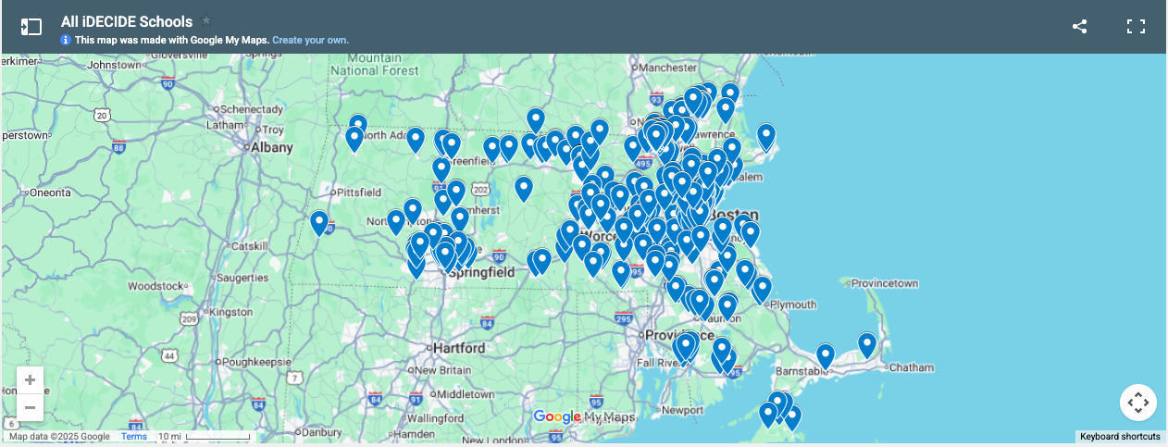
297 school partners
>50 iDECIDE facilitator trainings conducted
1,500+ trained facilitators

Slide 46
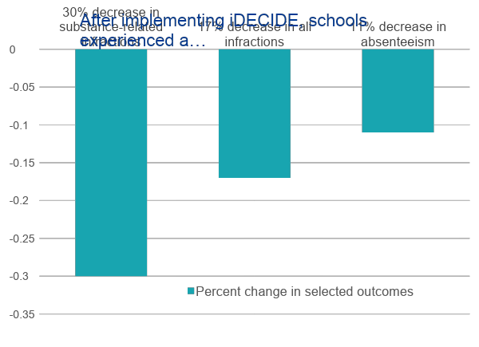
PRELIMINARY FINDINGS

Slide 47
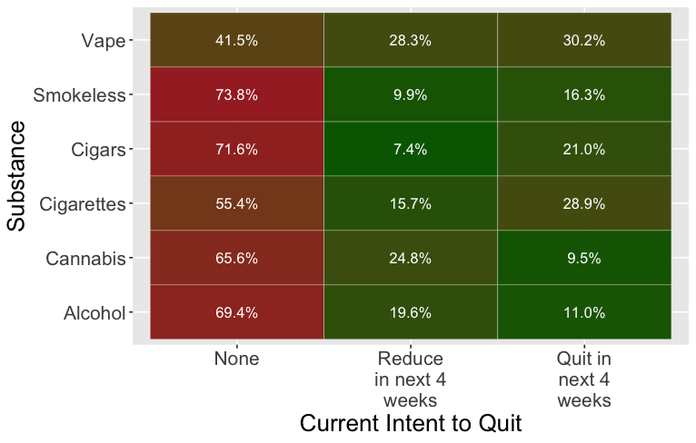
Student Intent to Quit

Slide 48



Please reach out with any questions or thoughts…
617-643-6673
RSCHUSTER@MGH.HARVARD.EDU

